Slide 1


Notes:
Introduction
• This is an awareness talk about hand arm vibration, part of Speedy Intelligent Safety programme
• It should take around 30mins
• We will cover:
– Who is affected
– What hand arm vibration syndrome (HAVS) looks like
– How vibration is measured – How to control vibration exposure
– What you can do now
• We will have a quick quiz at the end.

Slide 2

Notes:
Who is affected?
• Hand arm vibration is covered by the Control of Vibration at Work Regulations 2005
• Symptoms are progressive and not reversible
• Over five million workers use vibrating machinery at work
• Two million workers are exposed to potential danger levels, that’s 40% at direct risk
• 300,000 already have advanced symptoms
• More than one in 20 power tool users are suffering
• Does anyone know anyone who’s affected?

Slide 3
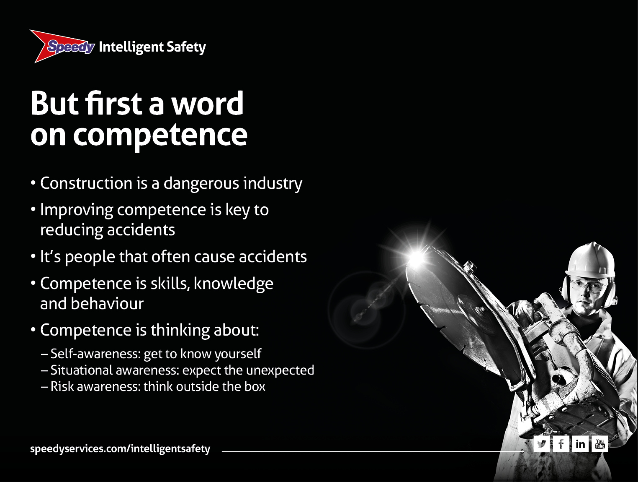
Notes:
But first a word on competence
• Standards of safety are improving all the time
• But construction is a dangerous occupation. Around 50 people die a year (that’s on average one a week) and thousands suffer ill health
• The industry believes that improving competence will reduce accidents
• But what is competence? We think of it as the skills and the know-how to do the job. BUT it is also about behaviour and the attitudes of people...because, it’s people that often cause accidents.
It involves:
– Self-awareness: get to know yourself
– Situational awareness: expect the unexpected
– Risk awareness: think outside the box.

Slide 4

Notes:
Self-awareness: get to know yourself
• This is where the person considers themself and their personal role in the process
• That means YOU and your frame of mind
• Late nights or hang-overs can all affect your judgement
• Domestic disputes like rows, emotional upsets, and stress can affect your attitude and concentration
• All that can affect your performance, your safety and the safety of others.

Slide 5
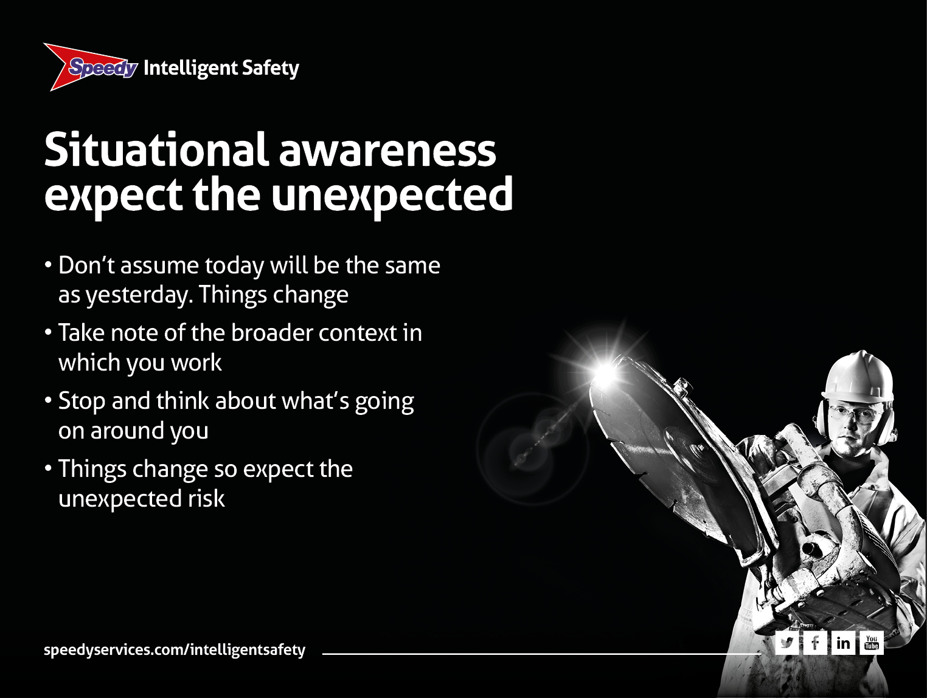
Notes:
Situational awareness: expect the unexpected
• Don’t assume that today will be the same as yesterday. Things change
• Situational awareness means taking note of the broader context in which you are working
• Take a moment to stop and think about what is going on around you
• For example – one minute there’s a track across a site and two hours later someone has dug a hole, ready for you to fall in. It wasn’t there before!

Slide 6
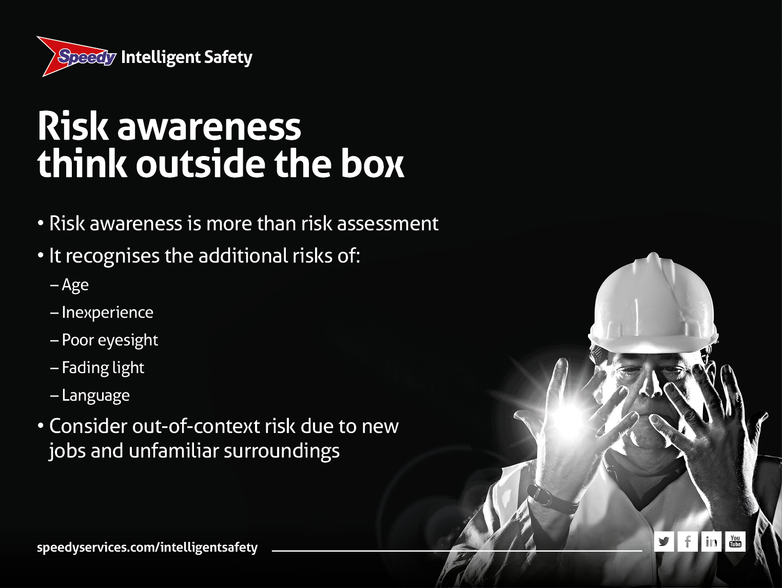
Notes:
Risk awareness: think outside the box
• Risk awareness is more than risk assessment
• It recognises the increased risks that relate to things beyond normal risk assessment
• Such as age, inexperience, poor eyesight, fading light and language
• A good example is out-of-context risk, where risk is increased because of working in a different part of the site or on a new job or in unfamiliar surroundings
• An example of this could be an operative who is asked to undertake a drilling task in a hazardous area where there is risk of combustion.

Slide 7
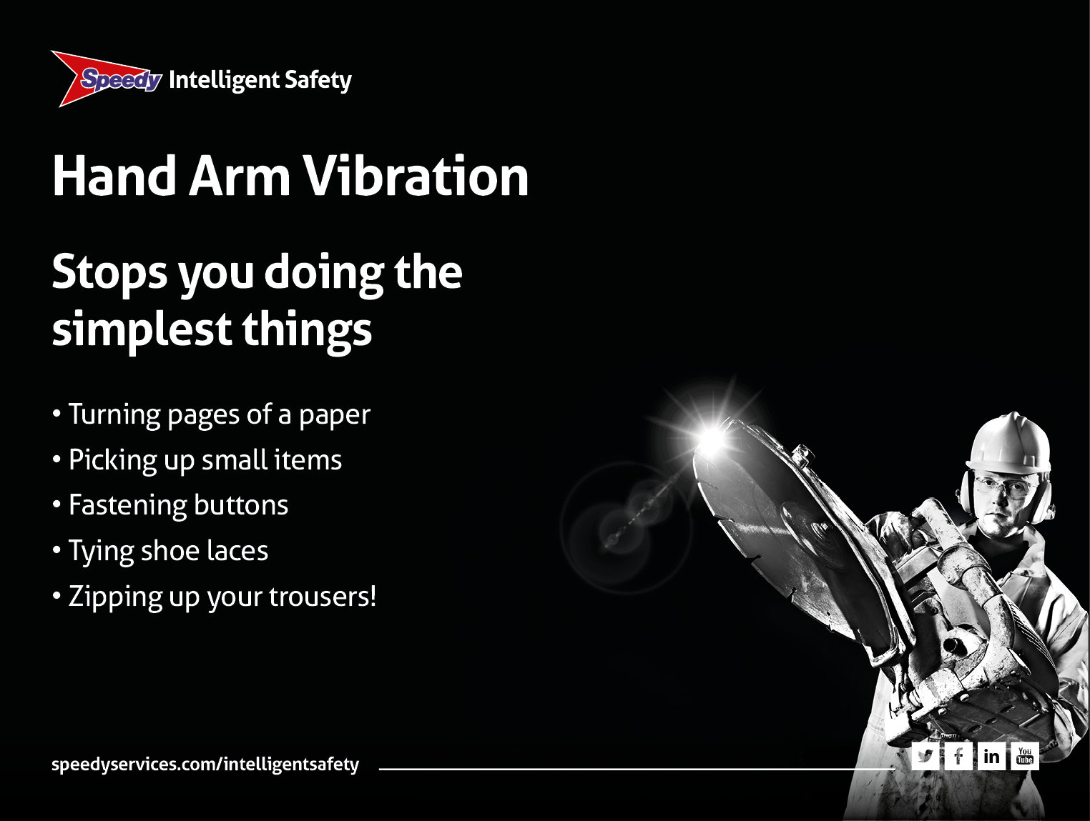
Notes:
Hand arm vibration
• HAVS is vibration transmitted into hands and arms whilst using hand-held power tools & machinery
• Prolonged and regular exposure to vibration can cause damage to nerve endings and affect blood circulation
• Hand arm vibration is seriously debilitating and can affect your work and your social life a great deal.

Slide 8
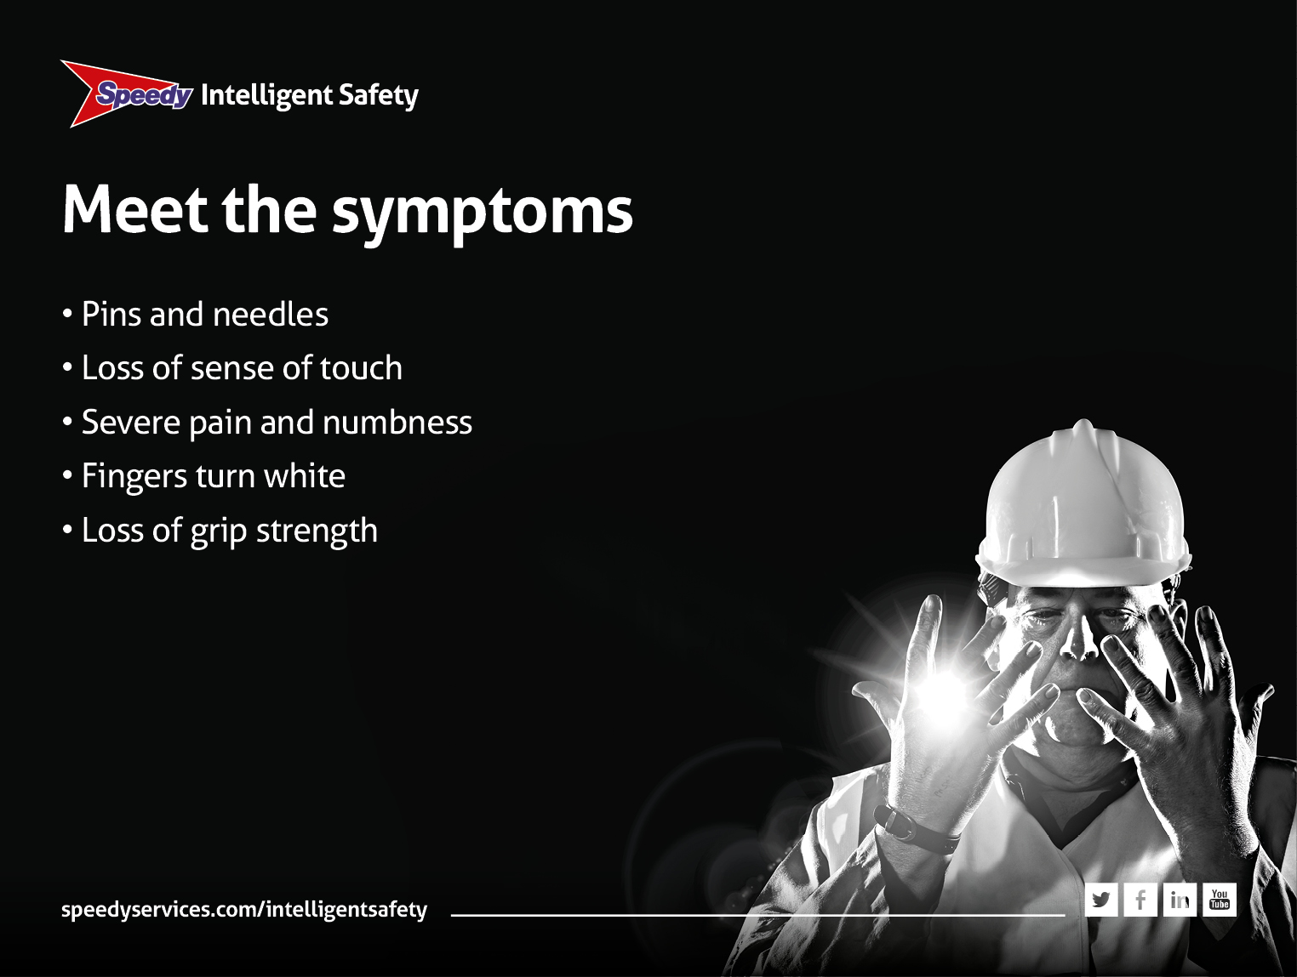
Notes:
Meet the symptoms
• Symptoms are progressive and not reversible:
– Pins and needles: irritating and uncomfortable
– Loss of touch: if you can’t feel it how do you know if it is hot or cold?
– Severe pain: when fingers go white in the cold and then red on recovery
– Loss of grip strength: you have to pick up tools with your wrist
– Carpal Tunnel Syndrome: constant pain in hand and wrist making sleeping difficult
• Does anybody recognise these symptoms?

Slide 9
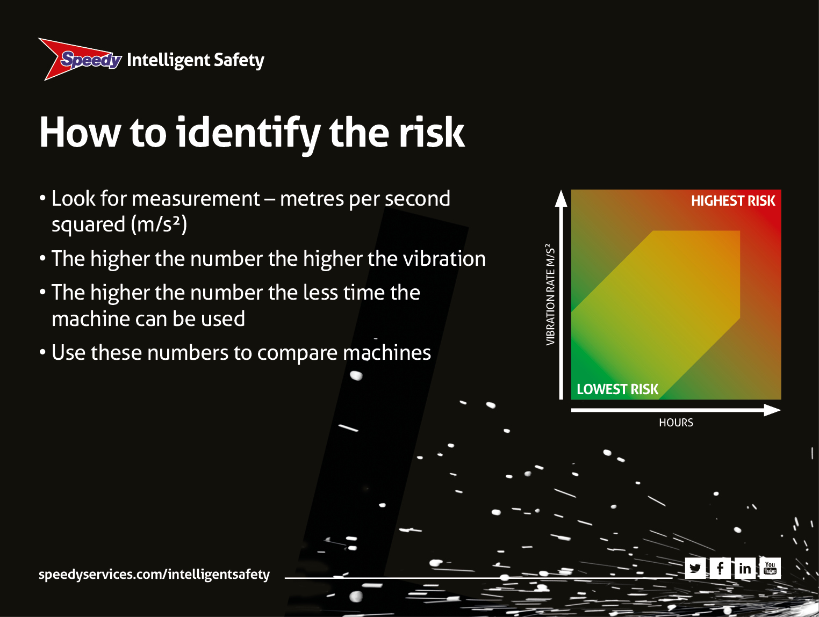
Notes:
How to identify the risk
• HSE shows a good road breaker measures five metres per second squared (m/s2) whilst a bad one measures 20 metres per second squared (m/s2)
• The good breaker can be used between two and eight hours with appropriate controls
• However the 20 metres per second squared (m/s2) breaker could only safely be used between eight and 30mins with appropriate controls.

Slide 10
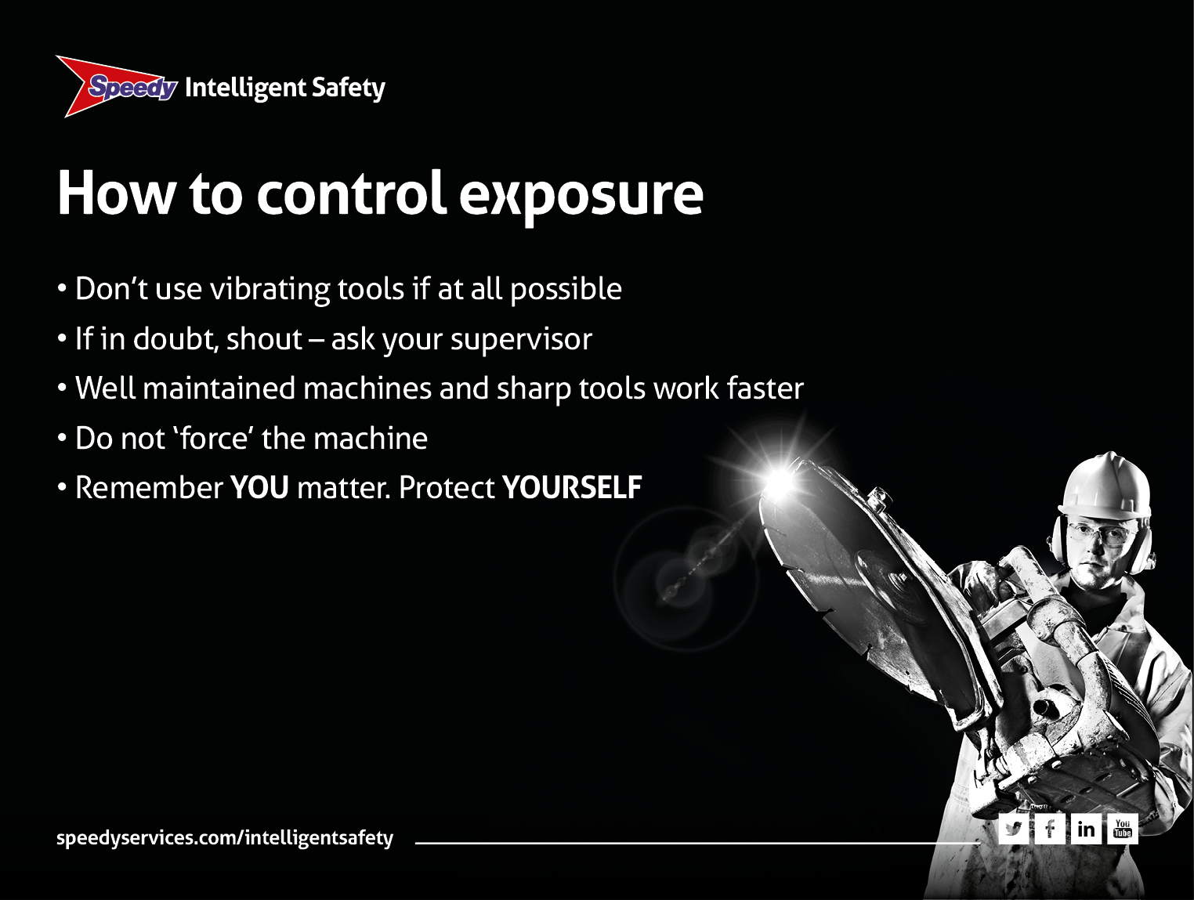
Notes:
How to control exposure
• Don’t use vibrating tools. Think of another way
• If you are not sure seek advice from a supervisor
• Sharp or well maintained tools work faster so create less exposure to vibration. It’s not just how much it vibrates, it’s how long it takes
• Do not force the machine. Let it do the work. Another reason for sharp drill bits and chisels
• Think about yourself. Take a break. keep warm and dry – especially hands (wear gloves). Remember smoking increases the risk.

Slide 11

Notes:
Do you have any choice
• Don’t use vibrating tools. Think of another way
• The law (Control of Vibration at Work Regulations 2005) says
“All employers shall take action to control and reduce exposure, provide information, instruction, training and regular health checks.” (source: HSE)
• The employer is doing their bit
• The law also say: “All employees shall take all reasonable steps to ensure that they comply with safety procedures, training and operating guidelines set out by the employer.” (source: HSE)
• It’s up to YOU to comply...after all it’s YOU that’s affected.

Slide 12
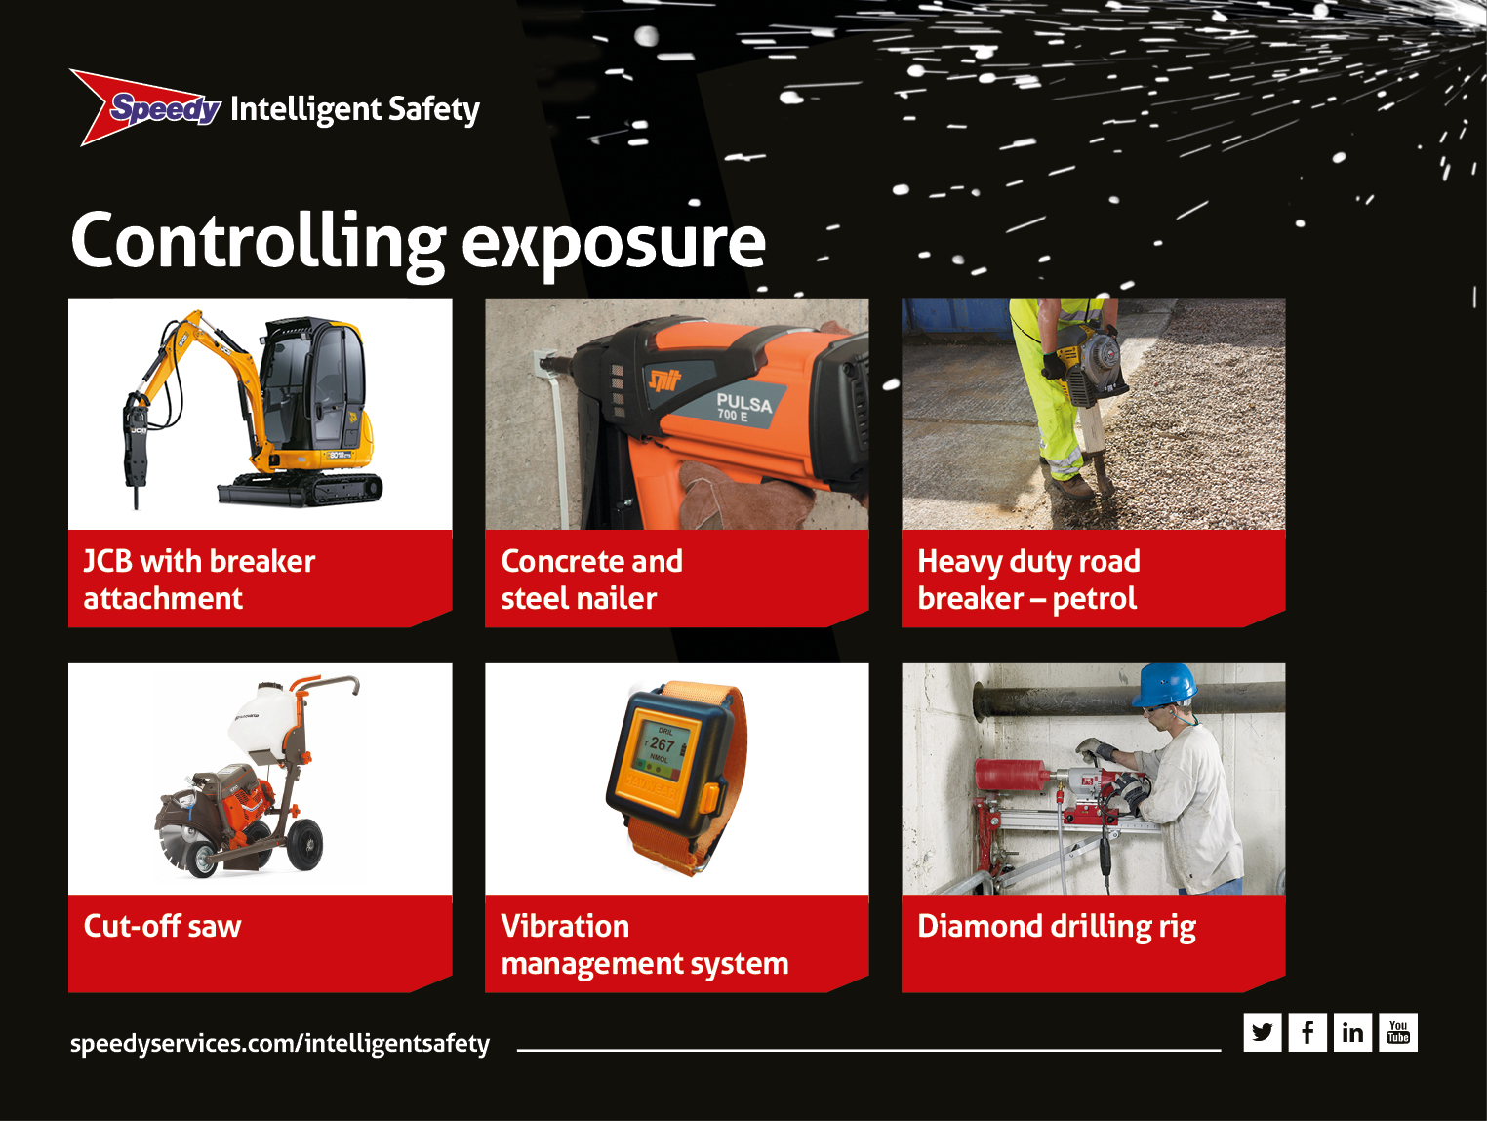
Notes:
Controlling exposure
• Here are some products to help you control vibration:
– The JCB with breaker attachment. Use a breaker attachment on an excavator rather than a hand-held breaker for larger jobs
– Concrete & steel nailer. Use nailers for fixings rather than a drill
– Heavy duty petrol road breaker. Use low vibration tools when possible
– Vibration management system. A vibration management system can prevent exposure to harmful levels of vibration
– Diamond drill with rig/cut-off saw with trolley. Use tools such as diamond drills with rigs and cut-off saws with trolleys to avoid holding tools.

Slide 13
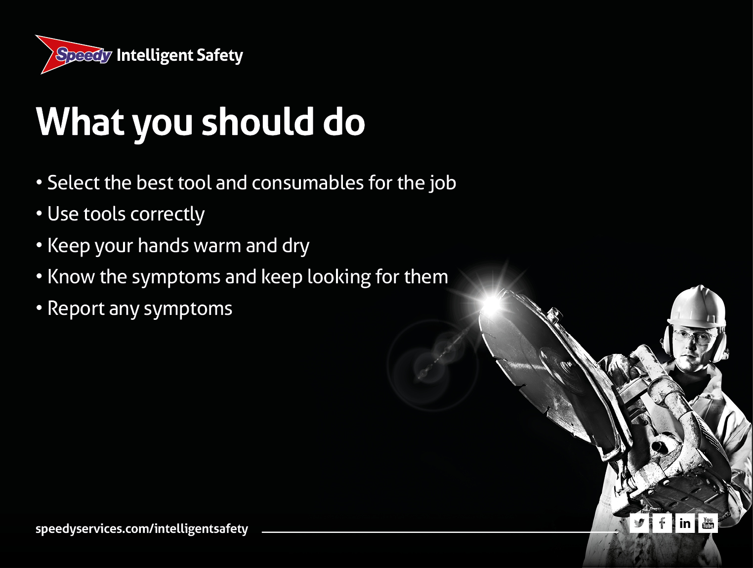
Notes:
What should you do
• Select the best tools and consumables for the job:
– Think modern, low vibration tools
– Think alternative methods, e.g. JCB with breaker attachment
– Think diamond drilling with rigs to avoid holding tools
• Gripping properly and not forcing all help
• There are training courses which Speedy can run. Ask your supervisor
• keep hands warm and use hand arm vibration gloves. Take breaks and also exercise your fingers. It all helps.
• keep an eye out for the symptoms and report them as soon as possible.

Slide 14
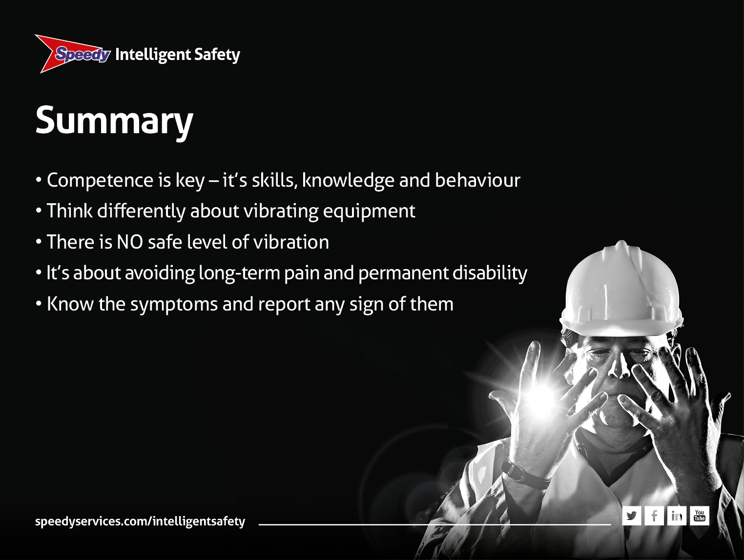
Notes:
Summary
• Competence is key – it’s skills, knowledge AND behaviour
• HAVS is a really serious condition that affects many thousands of people
• We need to think carefully about it when selecting and using vibrating equipment
• There is NO safe level of vibration and exposure to vibration must be minimised
• Preventing hand arm vibration is about avoiding long-term pain and permanent disability
• You must watch out for and report any symptoms
And finally before I go let’s have a quick quiz just to make sure you understand about hand arm vibration.

Slide 15
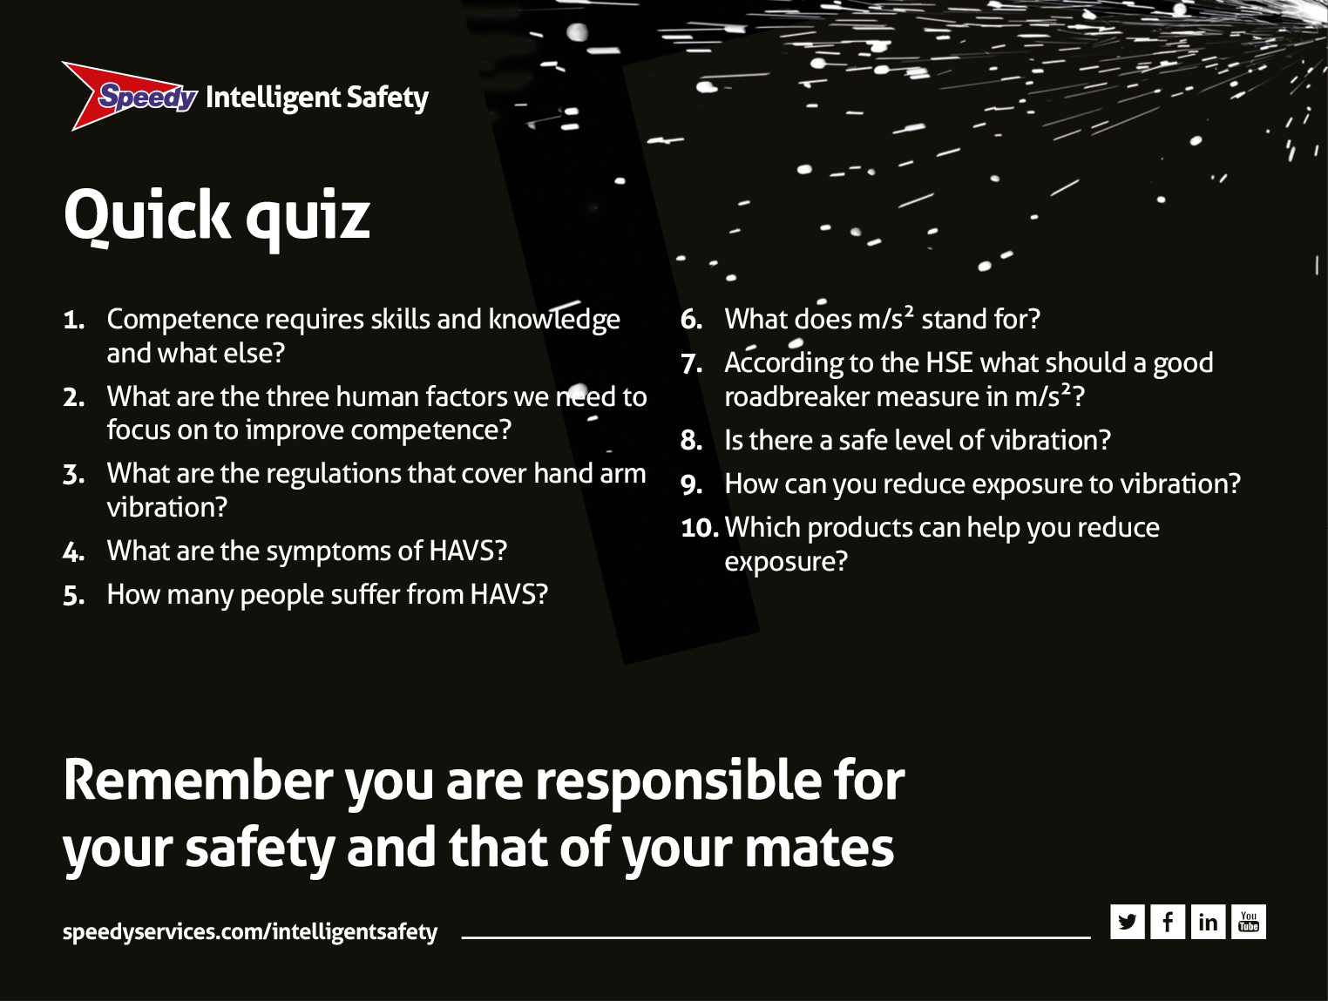
Notes:
Quick quiz
1. Competence requires skills and knowledge and what else?
Behaviour and attitudes – because it’s people that often cause accidents
2. What are the three human factors we need to focus on to improve competence?
Self-awareness, situational awareness and risk awareness
3. What are the regulations that cover hand arm vibration?
Control of Vibration at Work Regulations 2005
4. What are the symptoms?
Pins and needles, loss of sense of touch, pain/numbness, fingers turn white, loss of grip.
5. How many people suffer from HAVS?
300,000 or one in 20 power tool users
6. What does m/s2 stand for?
Metres per second squared
7. According to the HSE what should a good roadbreaker measure in m/s2?
Five metres per second squared
8. Is there a safe level of vibration?
No
9. How can you reduce exposure to vibration?
Don’t use vibrating tools, use low vibration tools, keep tools in good condition, don’t force the tool and if in doubt ask a supervisor.
10. Which products can help you reduce exposure?
JCB with breaker attachment, concrete and steel nailer, diamond drilling rig, heavy duty road breaker, cut-off saw and vibration management system.

