Slide 1

Notes:
Introduction
• This is an awareness talk on dust, which is part of our award-winning Safety from the ground up programme
• Safety from the ground up is part of One Plan, Speedy’s overarching sustainability strategy
• It will take around 30 minutes
• We will cover:
– Why dust is such a big issue
– What we mean by dust
– What you can do to control it
• We will have a quick quiz at the end.

Slide 2
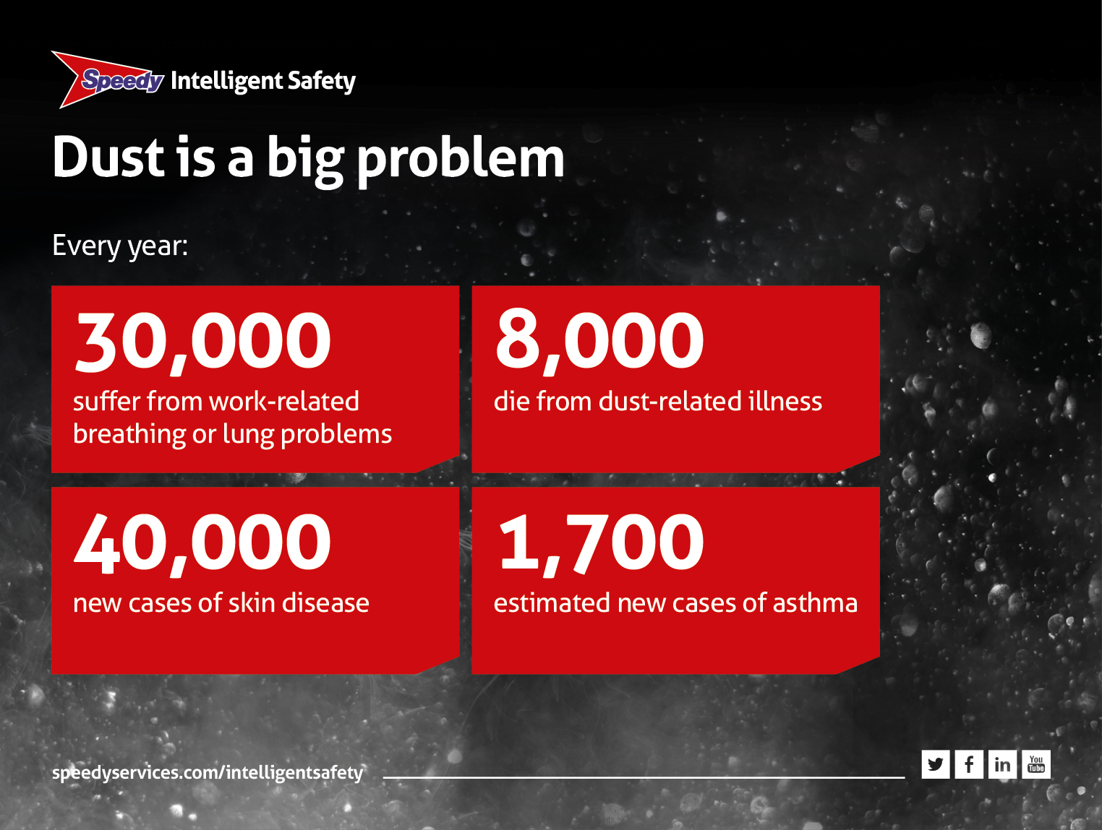
Notes:
Dust is a BIG problem
• Dust control is covered by two pieces of legislation.
• The Health and Safety at Work Act 1974 and the Control of Substances Hazardous to Health Regulations 2002 (COSHH)
• Asbestos is specifically covered by the Control of Asbestos Regulations 2012
• Our research shows that 80% of site workers are affected regularly and 20% claim it is a serious problem
• 20% claim it is a serious problem
• The HSE say that 42,110 people suffer from work-related breathing or lung problems
• 8,000 people die a year from dust-related illnesses, 4,000 from asbestos exposure and 4,000 from other dusts
• There are 110 new cases of dust-related skin disease each year
• There are around 85 new cases of occupational asthma reported every year.

Slide 3
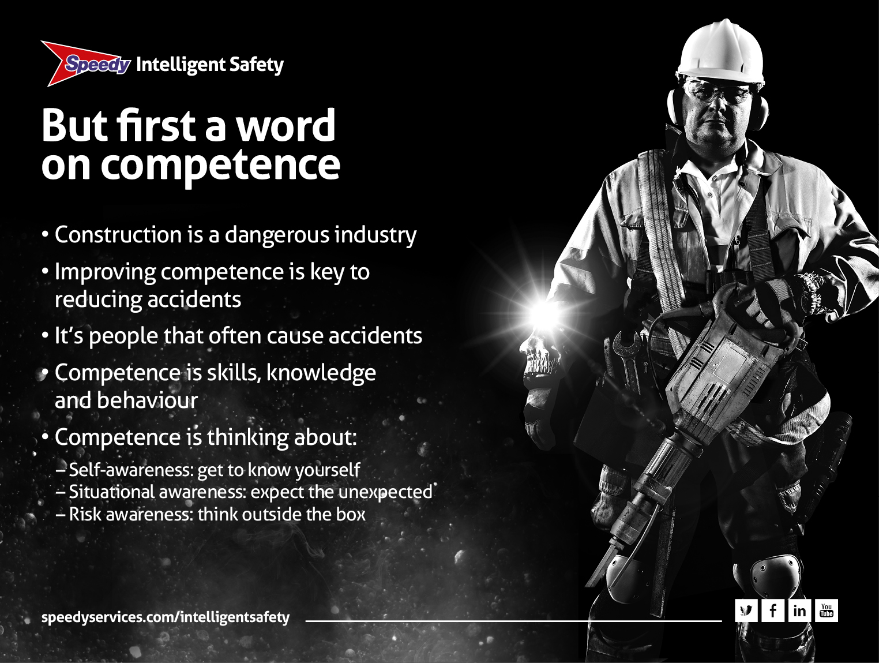
Notes:
But first a word on competence
• Standards of safety are improving all the time
• But construction is a dangerous occupation. Around 50 people die a year (that’s on average one a week) and thousands suffer ill health
• The industry believes that improving competence will reduce accidents
• But what is competence? We think of it as the skills and the know-how to do the job. BUT it is also about behaviour and the attitudes of people...because, it’s people that often cause accidents.
It involves:
– Self-awareness: get to know yourself
– Situational awareness: expect the unexpected
– Risk awareness: think outside the box.

Slide 4
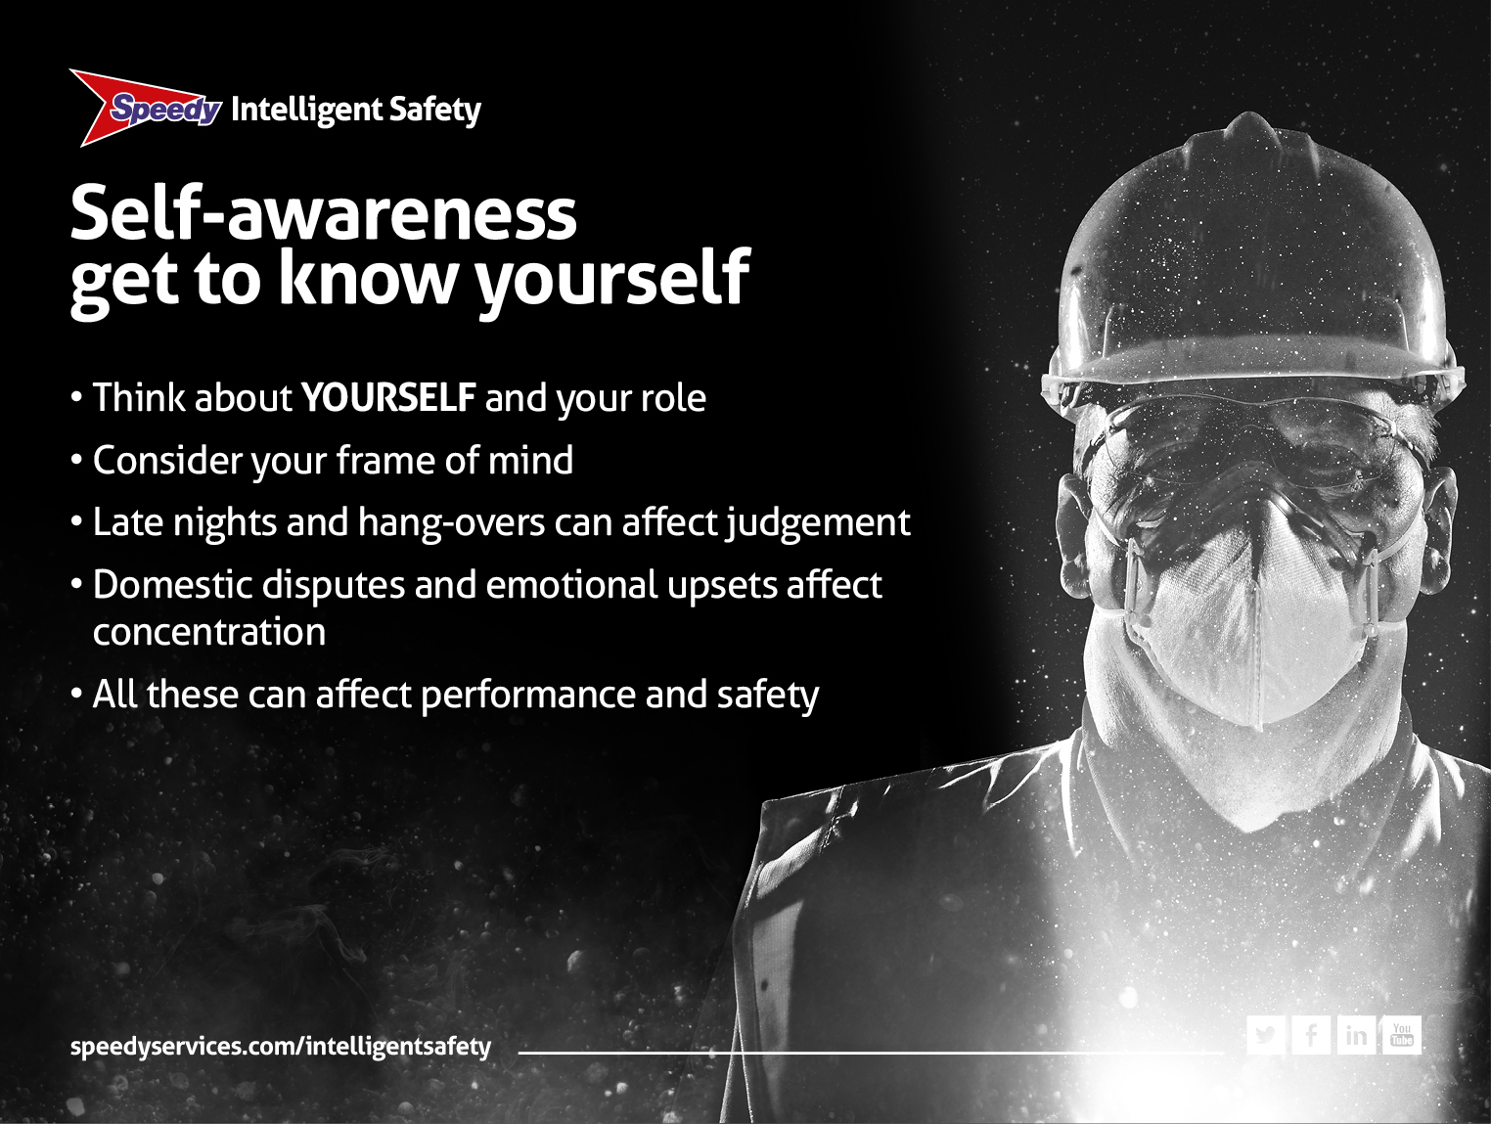
Notes:
Self-awareness: get to know yourself
• This is where the person considers themself and their personal role in the process
• That means YOU and your frame of mind
• Late nights or hang-overs can all affect your judgement
• Domestic disputes like rows, emotional upsets, and stress can affect your attitude and concentration
• All that can affect your performance, your safety and the safety of others.

Slide 5
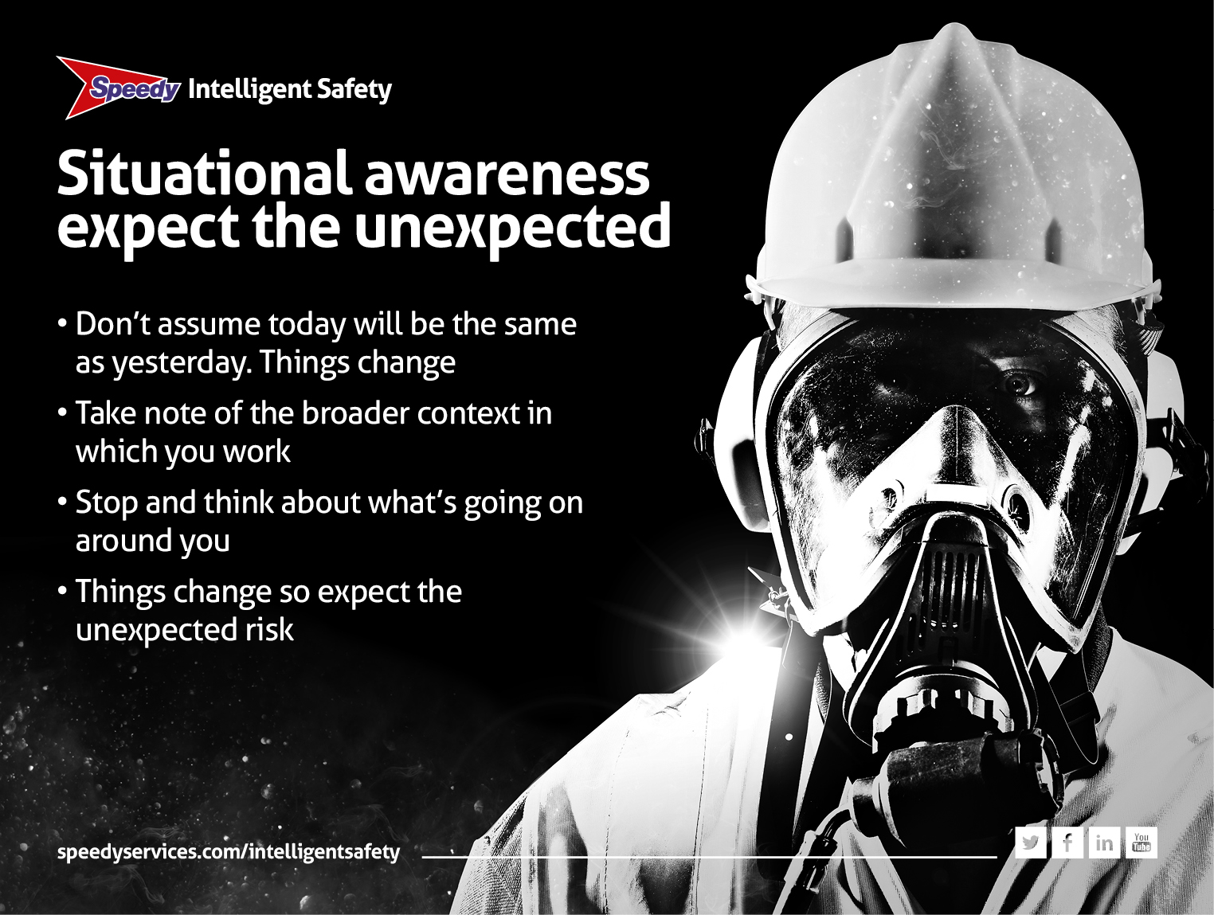
Notes:
Situational awareness: expect the unexpected
• Don’t assume that today will be the same as yesterday. Things change
• Situational awareness means taking note of the broader context in which you are working
• Take a moment to stop and think about what is going on around you
• For example – one minute there’s a track across a site and two hours later someone has dug a hole, ready for you to fall in. It wasn’t there before!

Slide 6
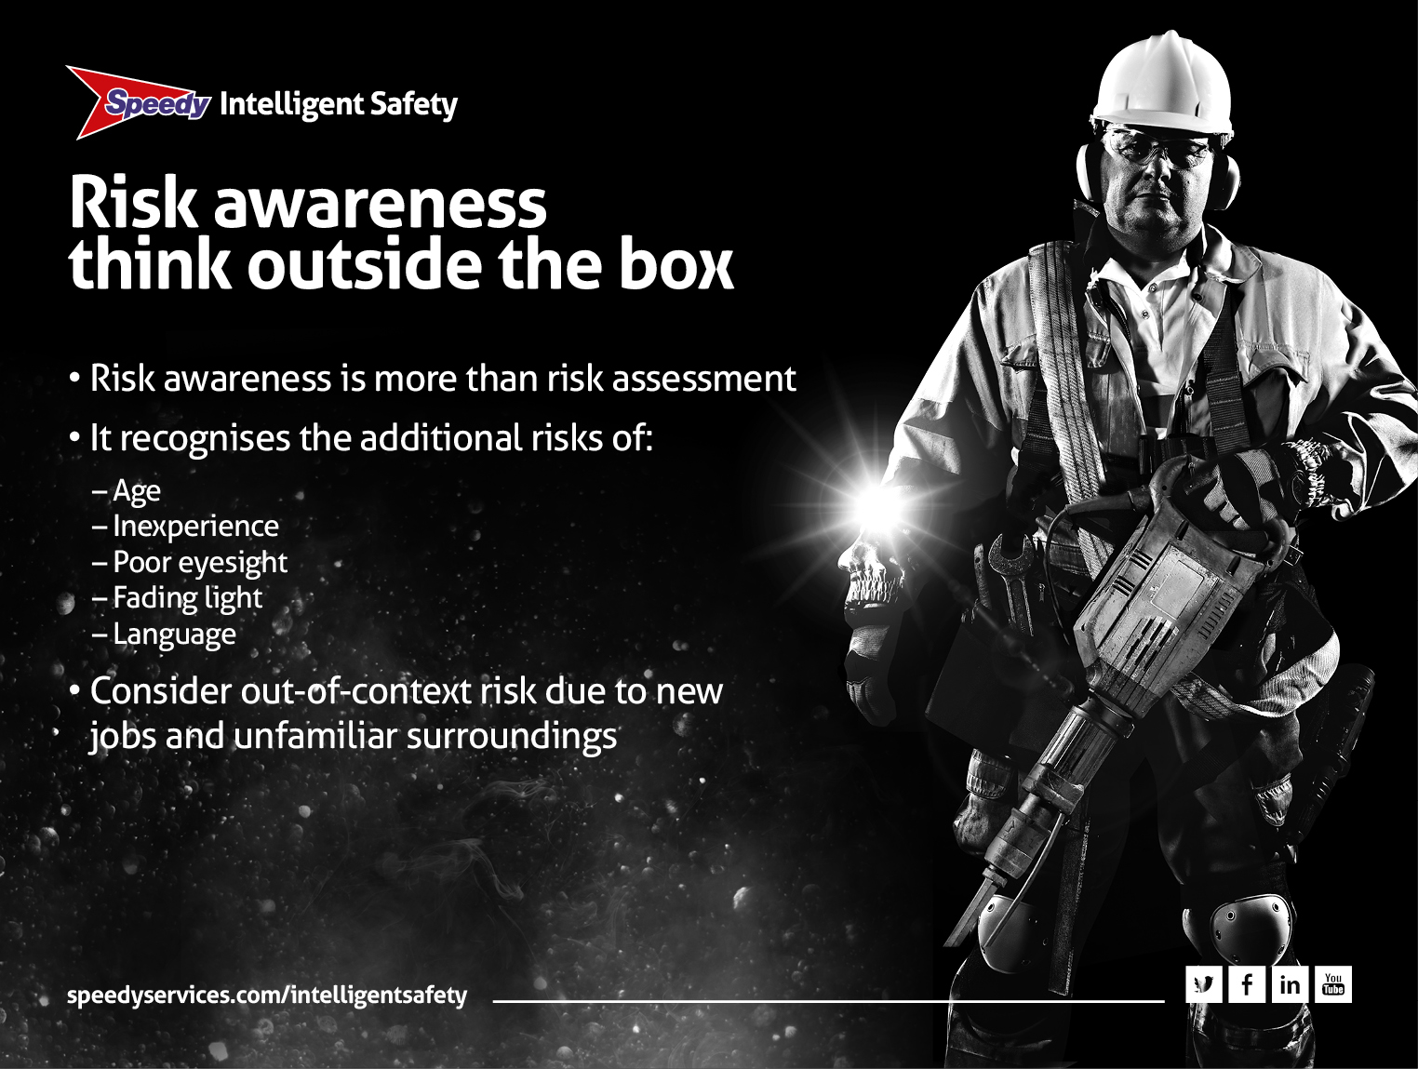
Notes:
Risk awareness: think outside the box
• Risk awareness is more than risk assessment
• It recognises the increased risks that relate to things beyond normal risk assessment
• Such as age, inexperience, poor eyesight, fading light and language
• A good example is out-of-context risk, where risk is increased because of working in a different part of the site or on a new job or in unfamiliar surroundings
• An example of this could be an operative who is asked to undertake work in unfamiliar surroundings such as near a demolition site where mould or asbestos may be present.

Slide 7
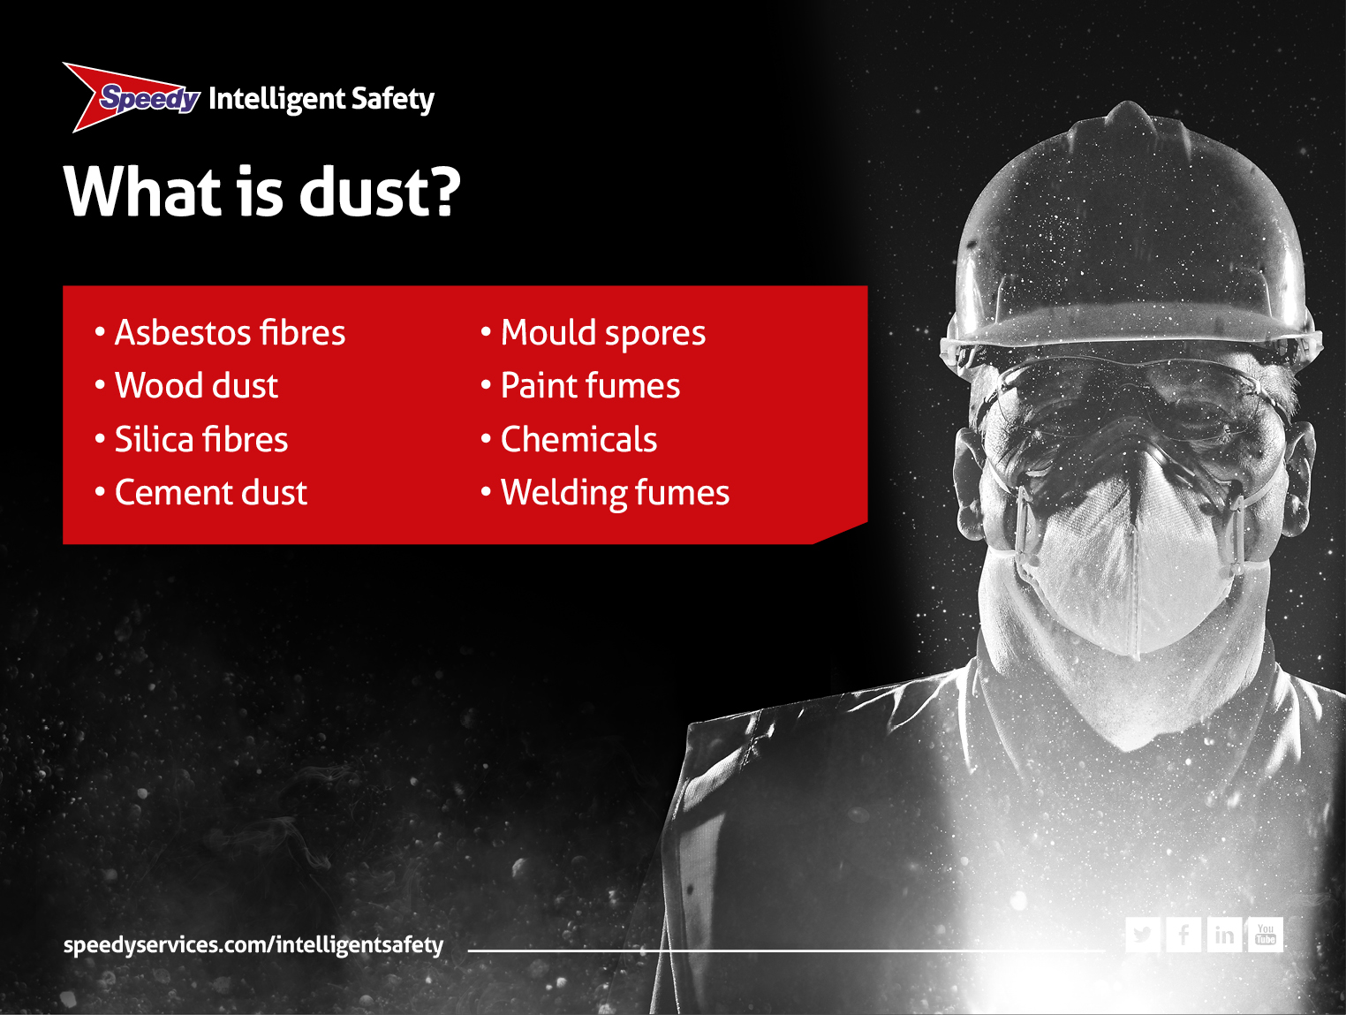
Notes:
What is dust?
• The term dust means all airborne particles, including fumes from welding and vapours from chemicals
• Clearly, there are lots of different types of dust
• And, a lot of it is pretty dangerous
• The HSE have identified ‘The Big Three’:
– Asbestos: it’s still a big killer and you MUST use a licensed contractor for removal
– Wood dust: including MDF, fibreboards, soft & hard wood, especially from sanding
– Silica dust: from cutting stone & concrete or using sand & gravel
• There are other dangerous dusts too including cement, mould, chemical vapours, fumes from diesel and welding
• But why are they so dangerous?

Slide 8

Notes:
The invisible killer
• A dust cloud contains some big and some very small particles
• You can see the big ones, but you can’t see the small ones – these are a fraction of the size of a grain of sand
• These invisible particles can linger in the air for up to eight hours
• They are so small, that when inhaled, go straight to the bottom of the lungs causing serious damage
• It can take a year for the body to get rid of these tiny particles
• Use dust monitoring equipment to identify invisible dust.

Slide 9
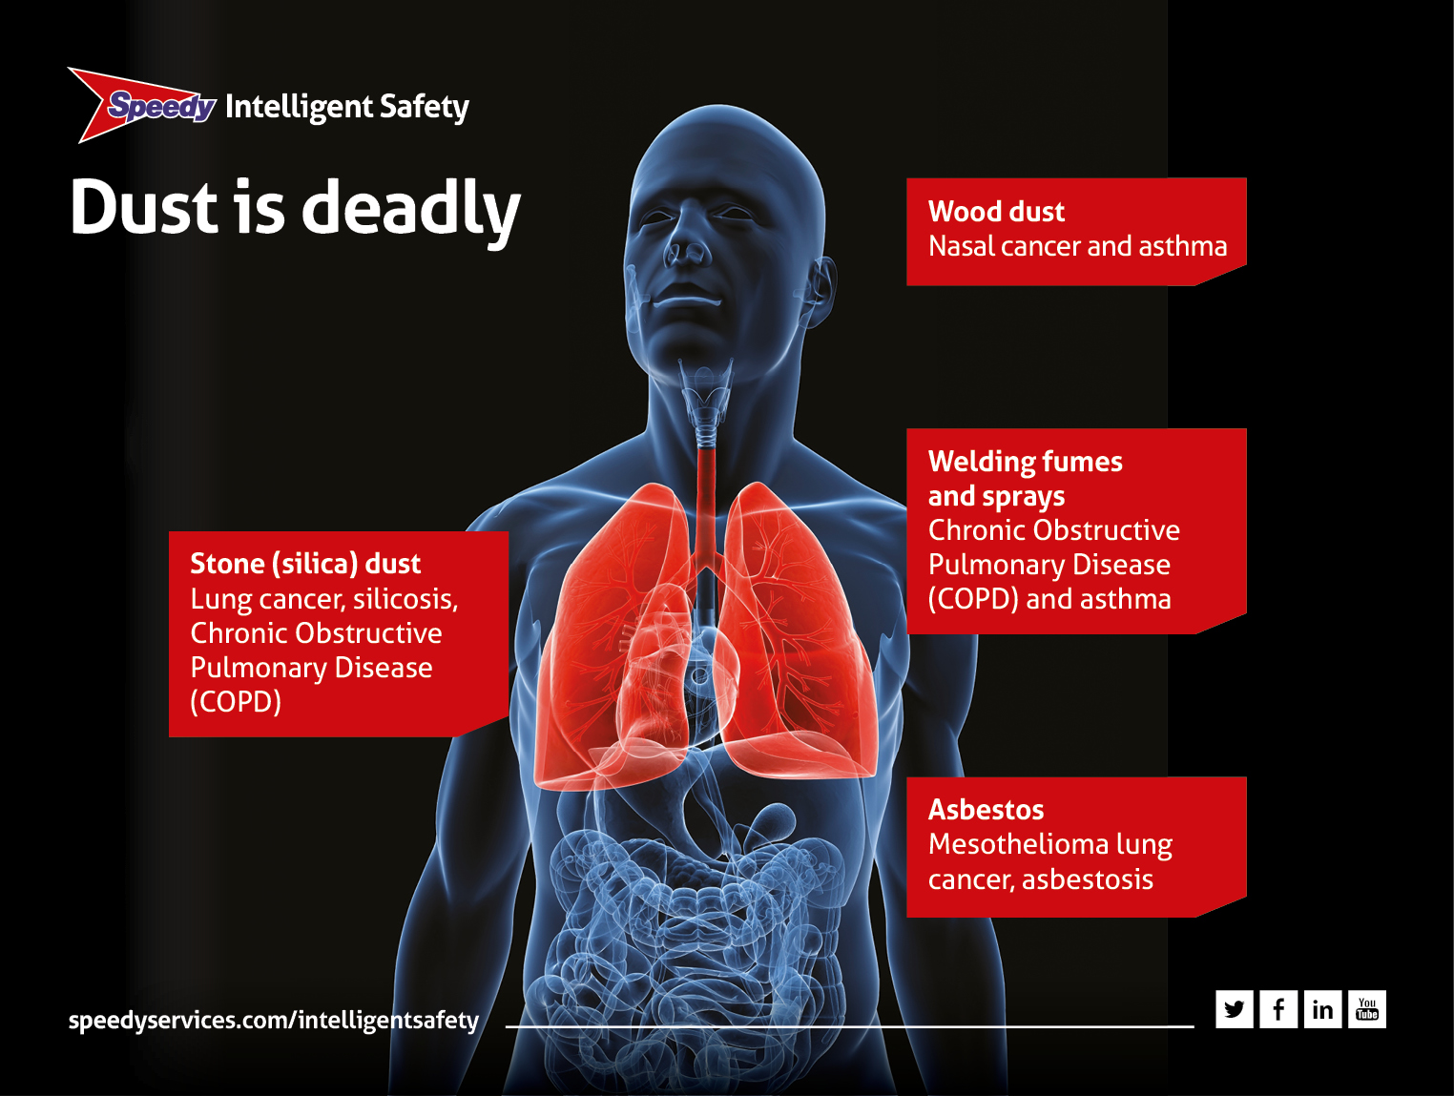
Notes:
Dust is deadly
• Dust causes long term serious illness and death
• As we have said, there are different types of dust
• They affect the body in different ways
• For example, wood dust affects the nasal area and can cause nasal cancer
• Silica dust, asbestos dust, welding fumes and sprays can go deep into the lung and cause silicosis, asbestosis, lung cancer and occupational asthma
• These are all serious illnesses that can badly affect your life
• And, in many cases, can kill you.

Slide 10
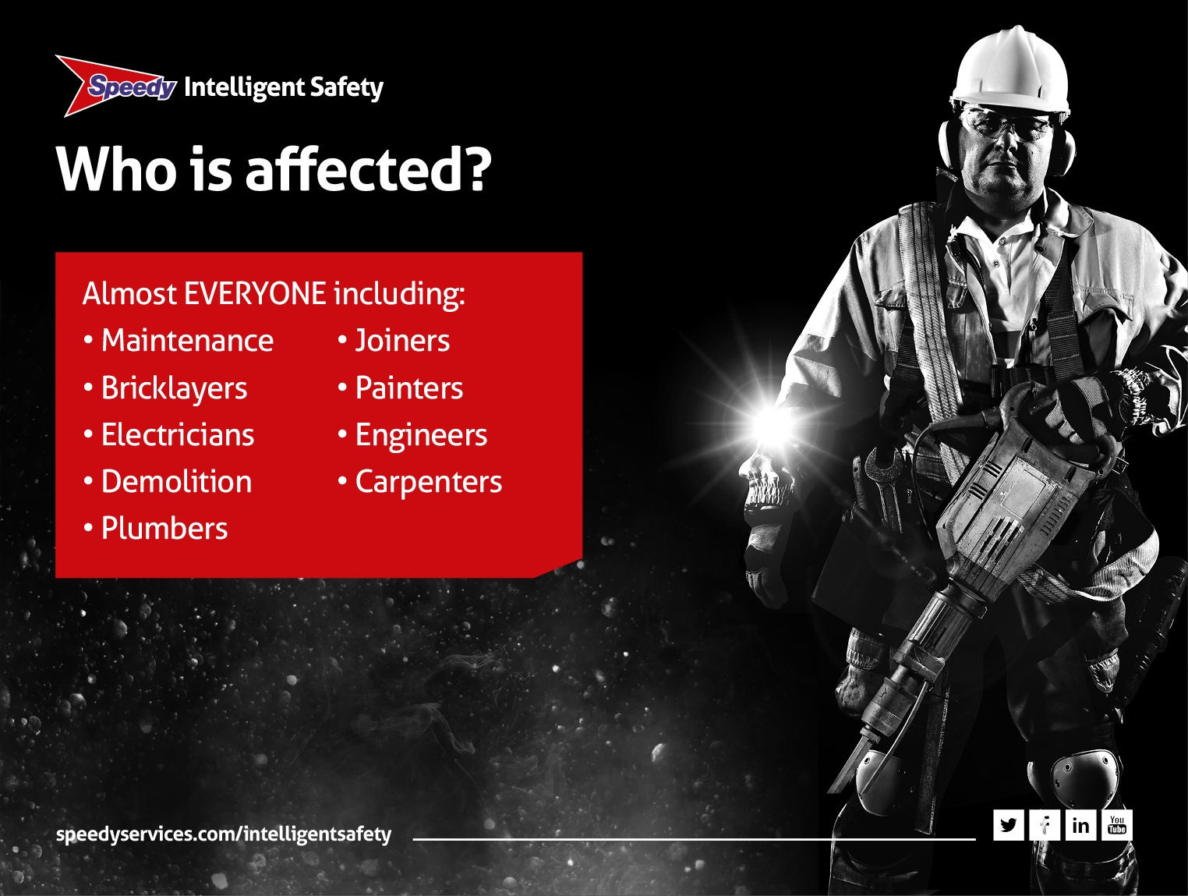
Notes:
Who is affected?
• It’s not just the people who cut kerbstones that are affected by dust
• Dust can affect almost every trade including plumbers, electricians, maintenance and demolition workers and painters etc.
• It doesn’t just affect these workers. It can also affect the people around them too e.g. members of the public and work colleagues
• You have a responsibility to look after your mates.

Slide 11
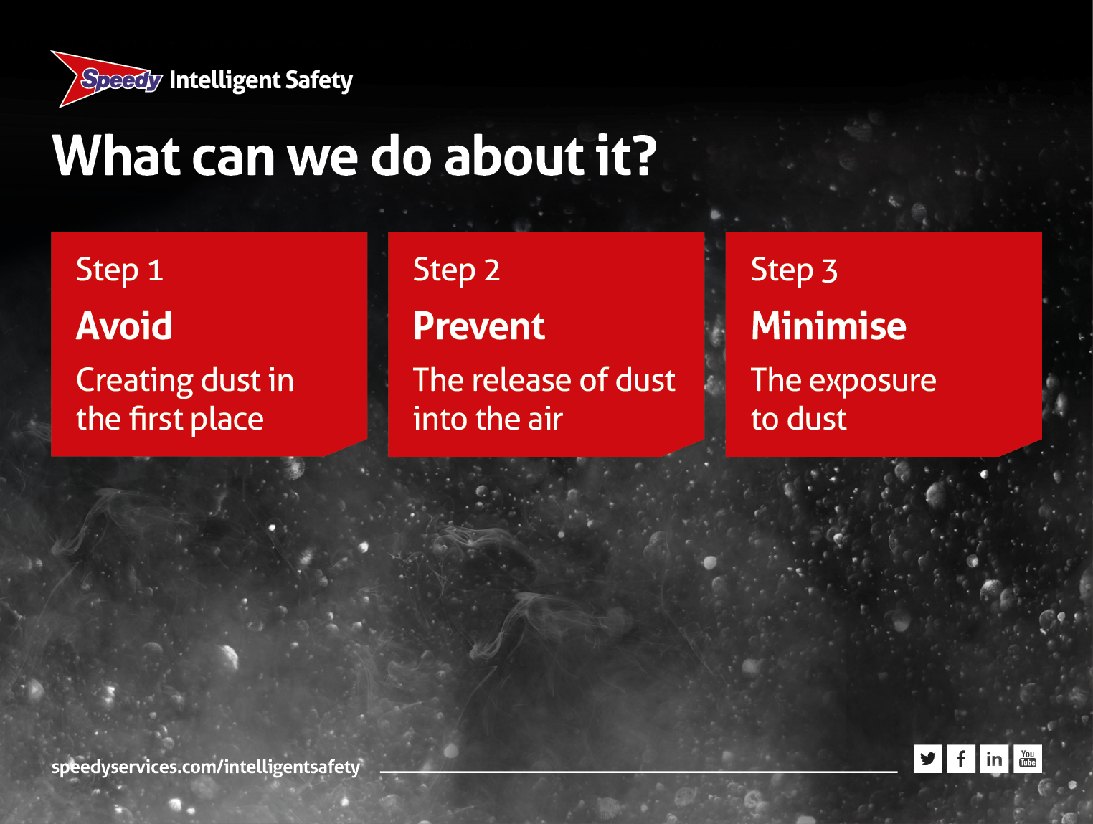
Notes:
What can we do about it?
• The law requires that your employer carries out a risk assessment before a task that may create dust is undertaken
• Step 1: avoid creating dust in the first place
– if you can’t avoid creating dust then
• Step 2: prevent the release of dust into the air as, once released, it‘s almost impossible to control
– and finally, if steps 1 and 2 can’t be achieved
• Step 3: you must minimise exposure to dust So, AVOID, PREVENT, MINIMISE, in that order.

Slide 12
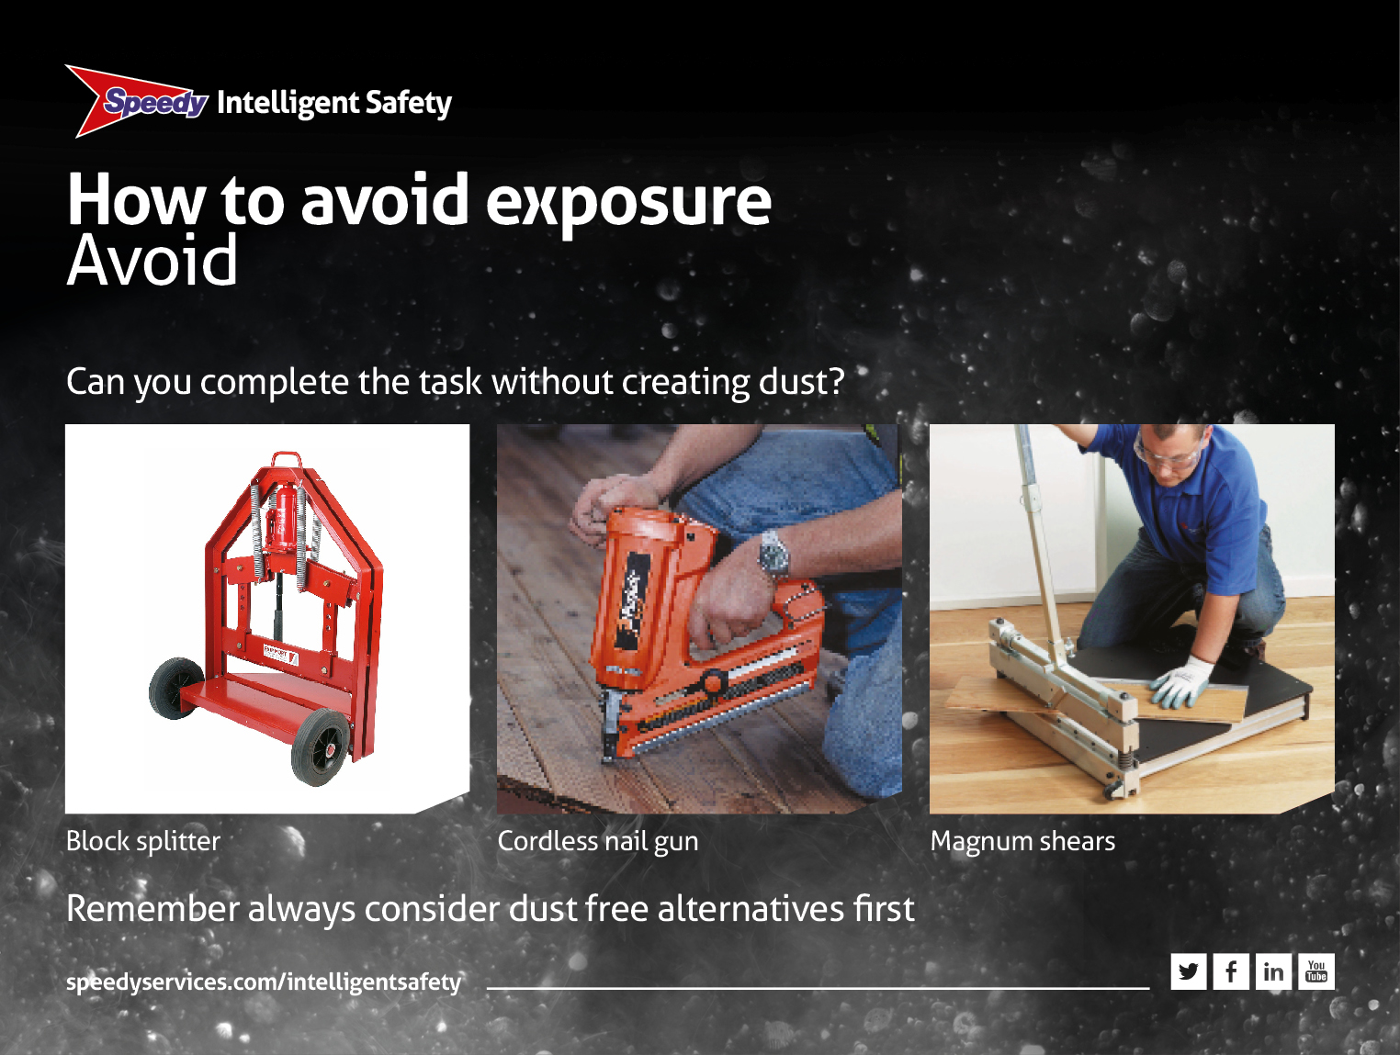
Notes:
How to control exposure
Avoid
You should always ask, ‘can I complete the task without creating dust?’
• E.g. could bricks or blocks be delivered pre-cut?
• Can you use alternative products that don’t create dust?
• Have you considered using products such as block splitters instead of a cut-off saw or angle grinder?
• Or a cordless nail gun instead of drilling
• Or magnum shears instead of using a jigsaw
• Remember, always consider dust free alternatives first.

Slide 13
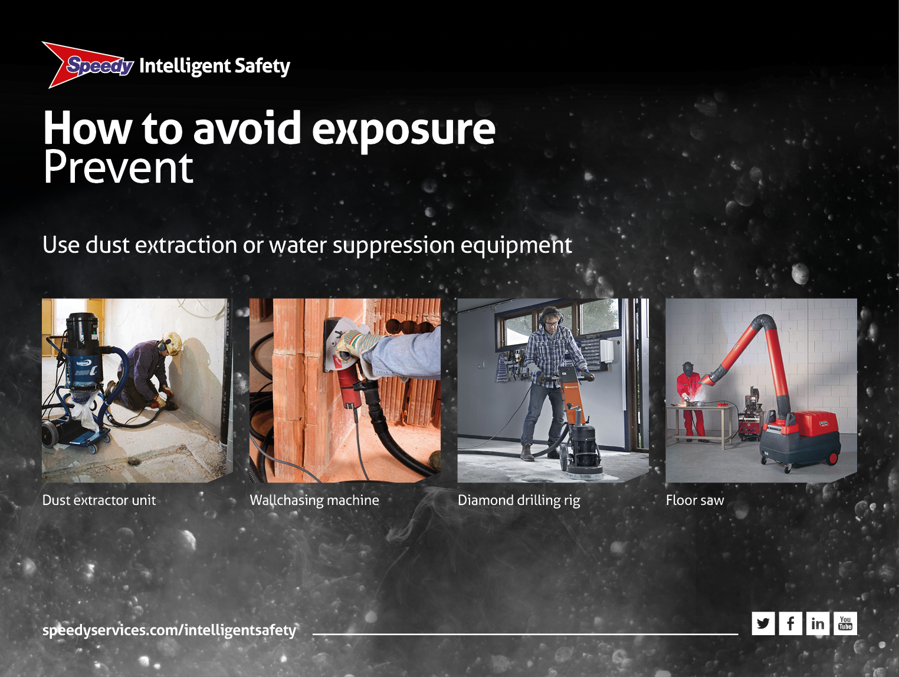
Notes:
How to control exposure
Prevent
• Use dust extraction or water suppression equipment to stop the dust getting into the air
• Here are some examples from our range of dust control equipment:
– Dust extractor unit
– Wallchasing machine
– Diamond drilling rig
– Floor saw

Slide 14
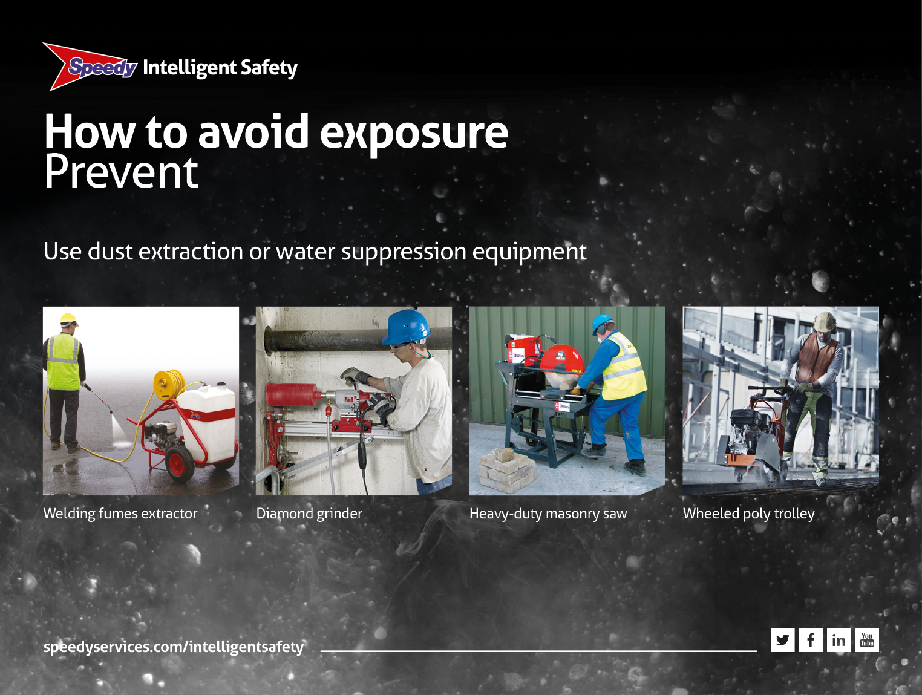
Notes:
How to control exposure
Prevent
• Use dust extraction or water suppression equipment to stop the dust getting into the air
• Here are some examples from our range of dust control equipment:
– Welding fumes extractor
– Diamond grinder
– Heavy-duty masonry saw
– Wheeled poly trolley.

Slide 15
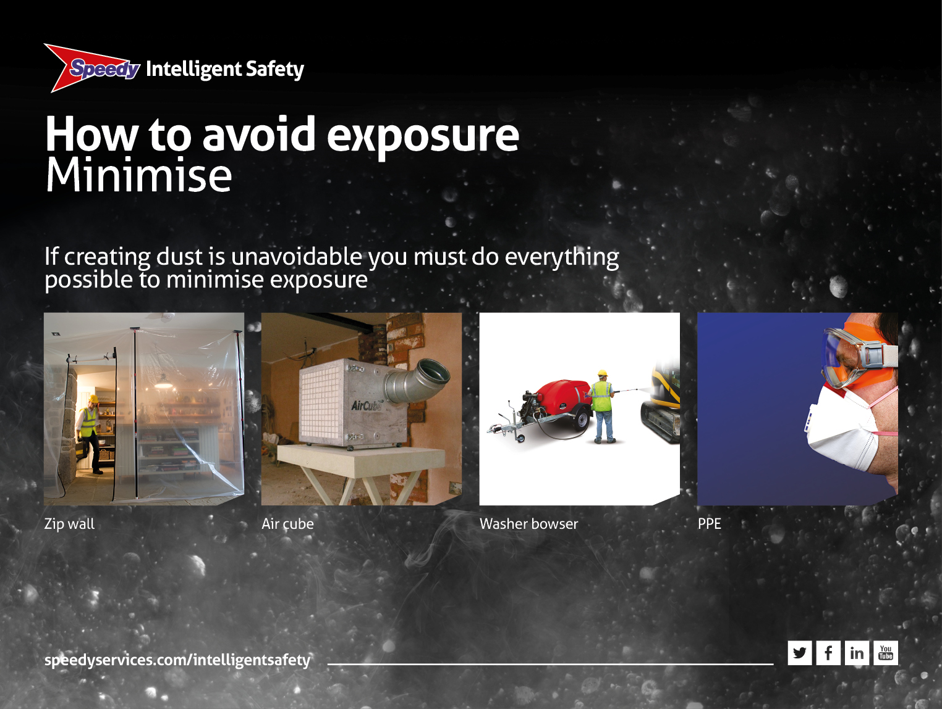
Notes:
How to control exposure
Minimise
• Use dust extraction or water suppression equipment to stop the dust getting into the air
• If creating dust is unavoidable, you must do everything possible to minimise exposure
• There are products available to help, for example:
– Zip wall: for containment
– Air cube: cleaning the air
– Washer bowser: avoids dust becoming airborne
– There is also obviously PPE
This is your LAST, not FIRST line of defence so consider avoiding the creation of dust first. You must select the right PPE for the job and make sure it fits correctly
• Don’t just think about dust masks. Consider goggles, gloves etc
• For high levels of dust exposure consider using breathing apparatus.

Slide 16
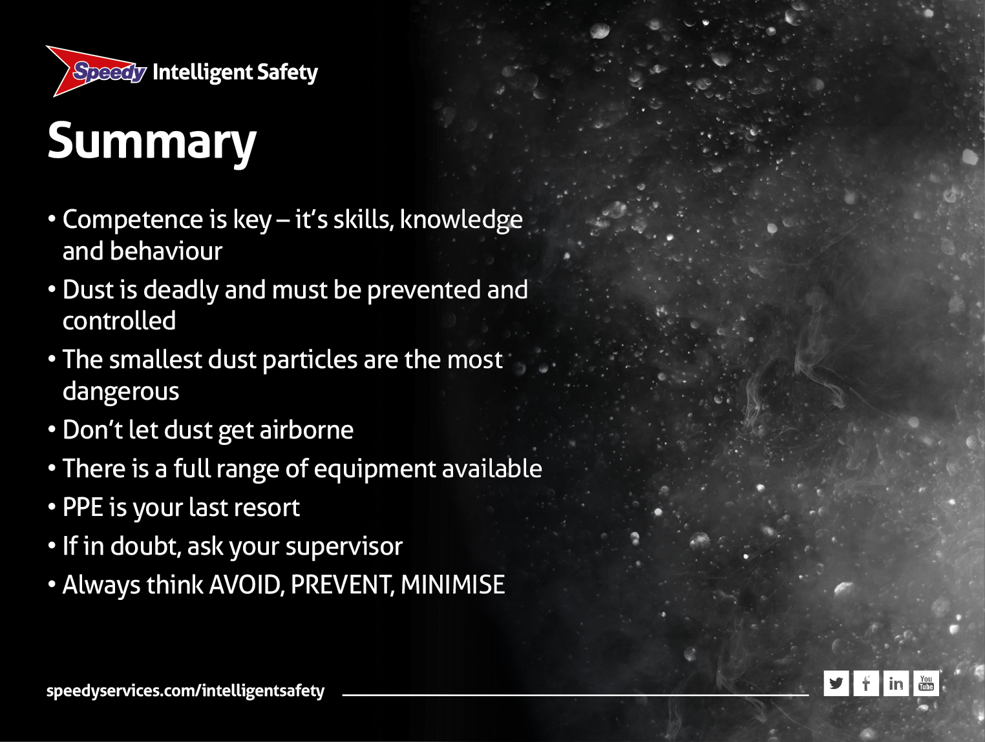
Notes:
Summary
• Competence is key – it’s skills, knowledge AND behaviour
• Dust is deadly and must be prevented and controlled
• The smallest dust particles are the most dangerous
• Don’t let dust get airborne
• There is a full range of equipment available
• PPE is your last resort • If in doubt, ask your supervisor
• Always think AVOID, PREVENT, MINIMISE
• And finally before I go let’s have a quick quiz just to make sure you understand about dust.

Slide 17
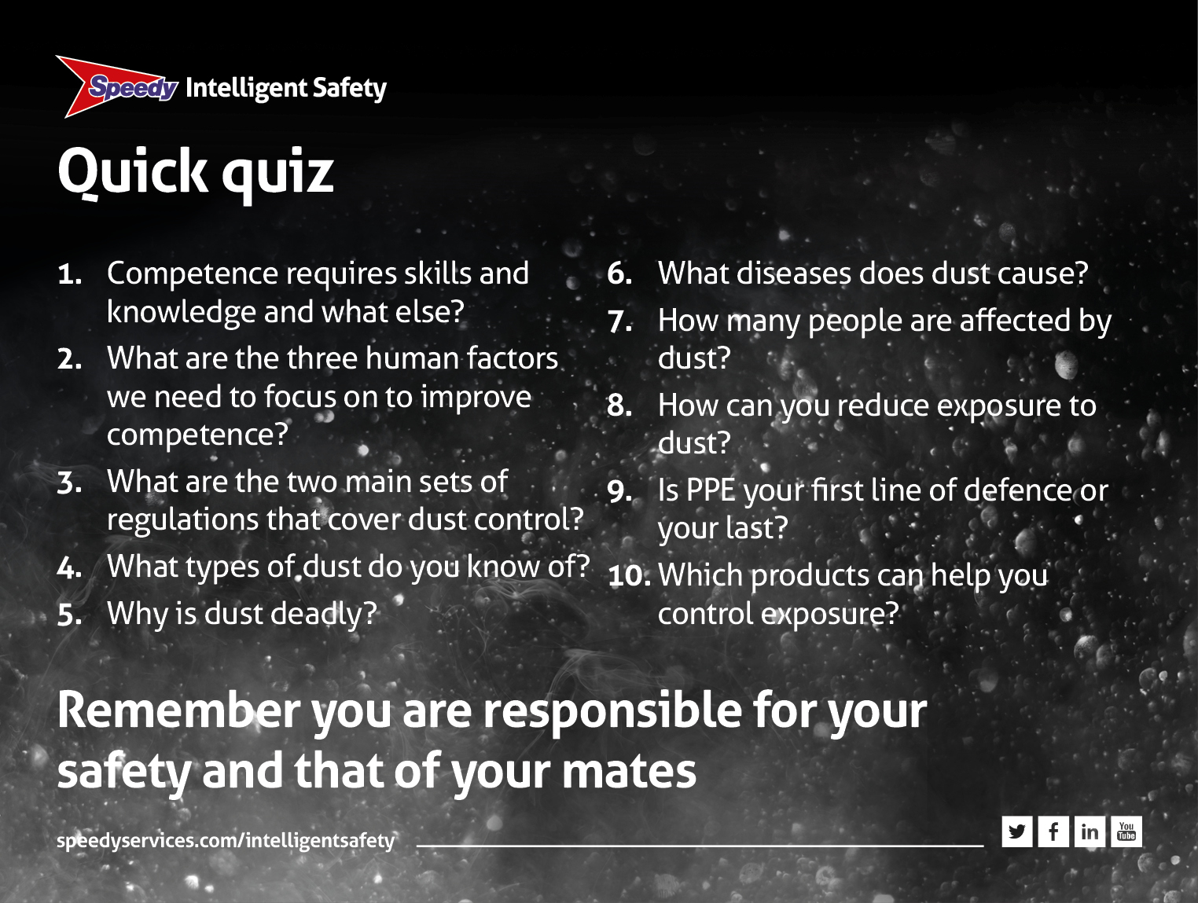
Notes:
Quick quiz
1. Competence requires skills and knowledge and what else?
Behaviour and attitudes – because it’s people that often cause accidents
2. What are the three human factors we need to focus on to improve competence?
Self-awareness, situational awareness and risk awareness
3. What are the two main sets of regulations that cover dust control?
The Health and Safety at Work Act 1974 and the Control of Substances Hazardous to Health Regulations 2002 (COSHH)
4. What types of dust do you know of?
Asbestos, wood dust, silica, mould, paint, chemical and welding fumes
5. Why is dust deadly?
Tiny particles, invisible to the naked eye, lodge in the lungs
6. What diseases does dust cause?
Asbestosis, silicosis, cancer, chronic obstructive pulmonary disease (COPD)
7. How many people are affected by dust?
42,110 people suffer from work-related breathing and lung problems and 8,000 die each year across UK industry
8. How can you reduce exposure to dust?
Avoid creating dust by using alternative tools, prevent dust getting airborne, minimise exposure:
9. Is PPE your first line of defence or your last?
Last
10. Which products can help you control exposure?
Dust extractor unit, wallchasing machine, diamond drilling rig, floor saw, cordless nail gun, air cube and PPE.

