Slide 1
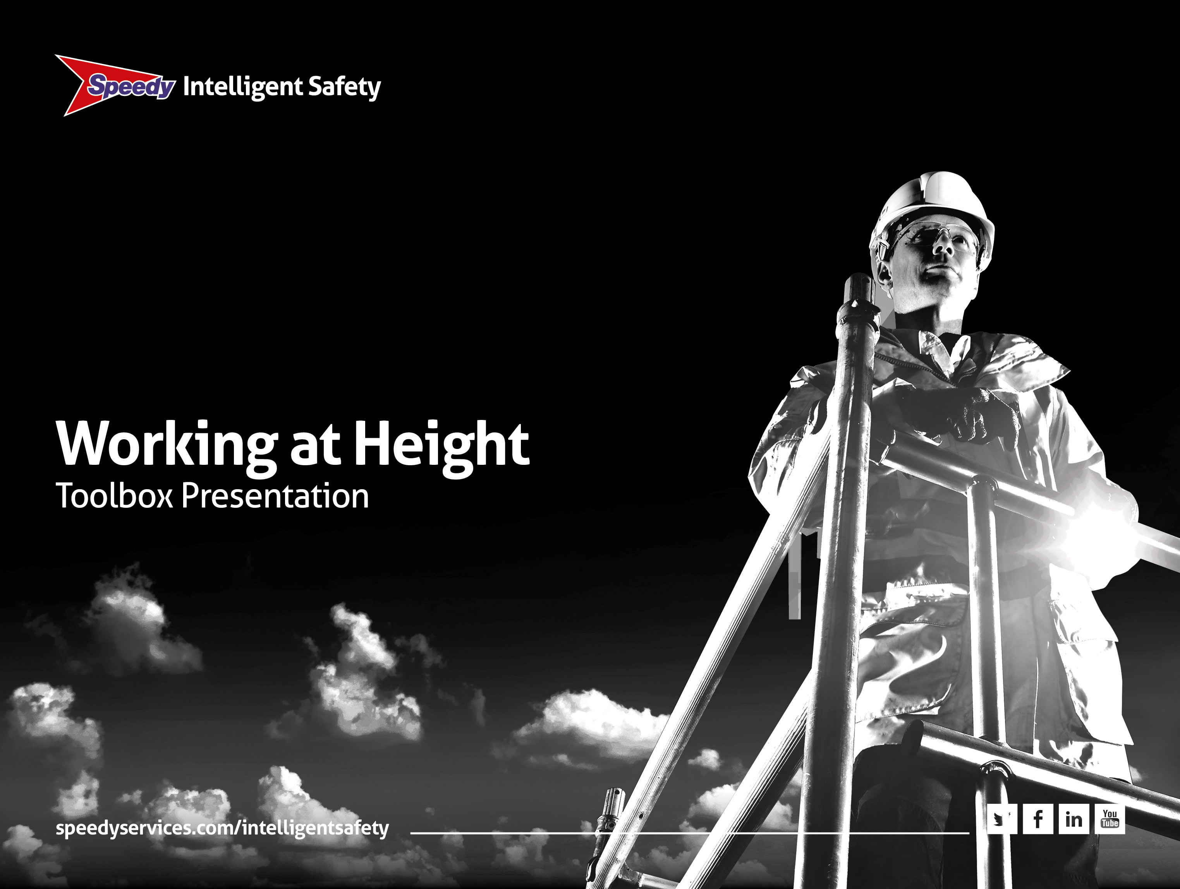
Notes:
Introduction
• This is an awareness talk about working at height,
• It should take around 30mins
• We will cover the six guiding principles of the Work at Height Regulations 2005 (as amended):
– Apply to anyone, anywhere at any height where a fall could cause personal injury
– Risk assessment
– Select the right equipment
– Use the equipment correctly
– Requires competence and planning
– Collective responsibility
• We will have a quick quiz at the end.

Slide 2
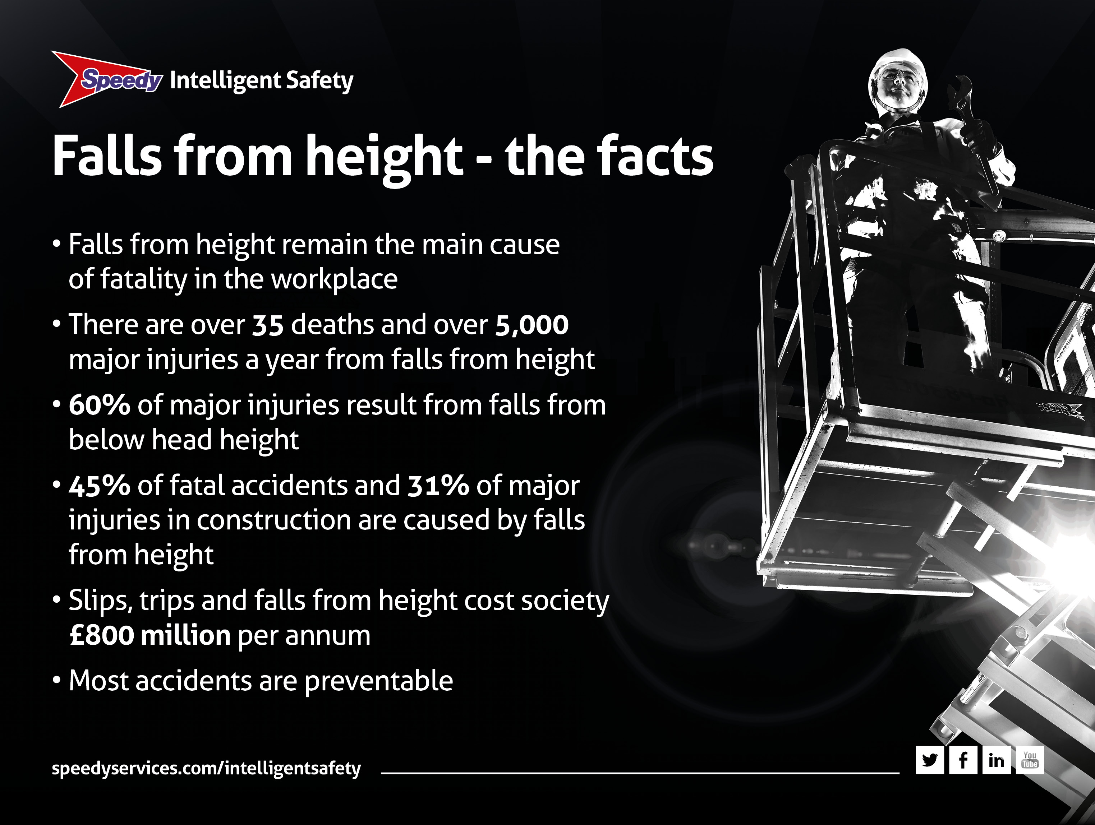
Notes:
Falls from height – the facts
• Let’s focus on working at height and the facts
• Safety standards are improving all the time but the facts are frightening
• Falls from height remain the main cause of fatality in the workplace
• There are over 35 deaths and over 4,000 major injuries a year from falls from height
• Amazingly 60% of major injuries result from falls from below head height
• Over 45% of fatal accidents and 31% of major injuries in construction are caused by falls from height
• Slips, trips and falls from height cost society £800 million a year
• Most of these accidents are preventable and with a little bit of thought and a little bit of application these numbers can be reduced.

Slide 3
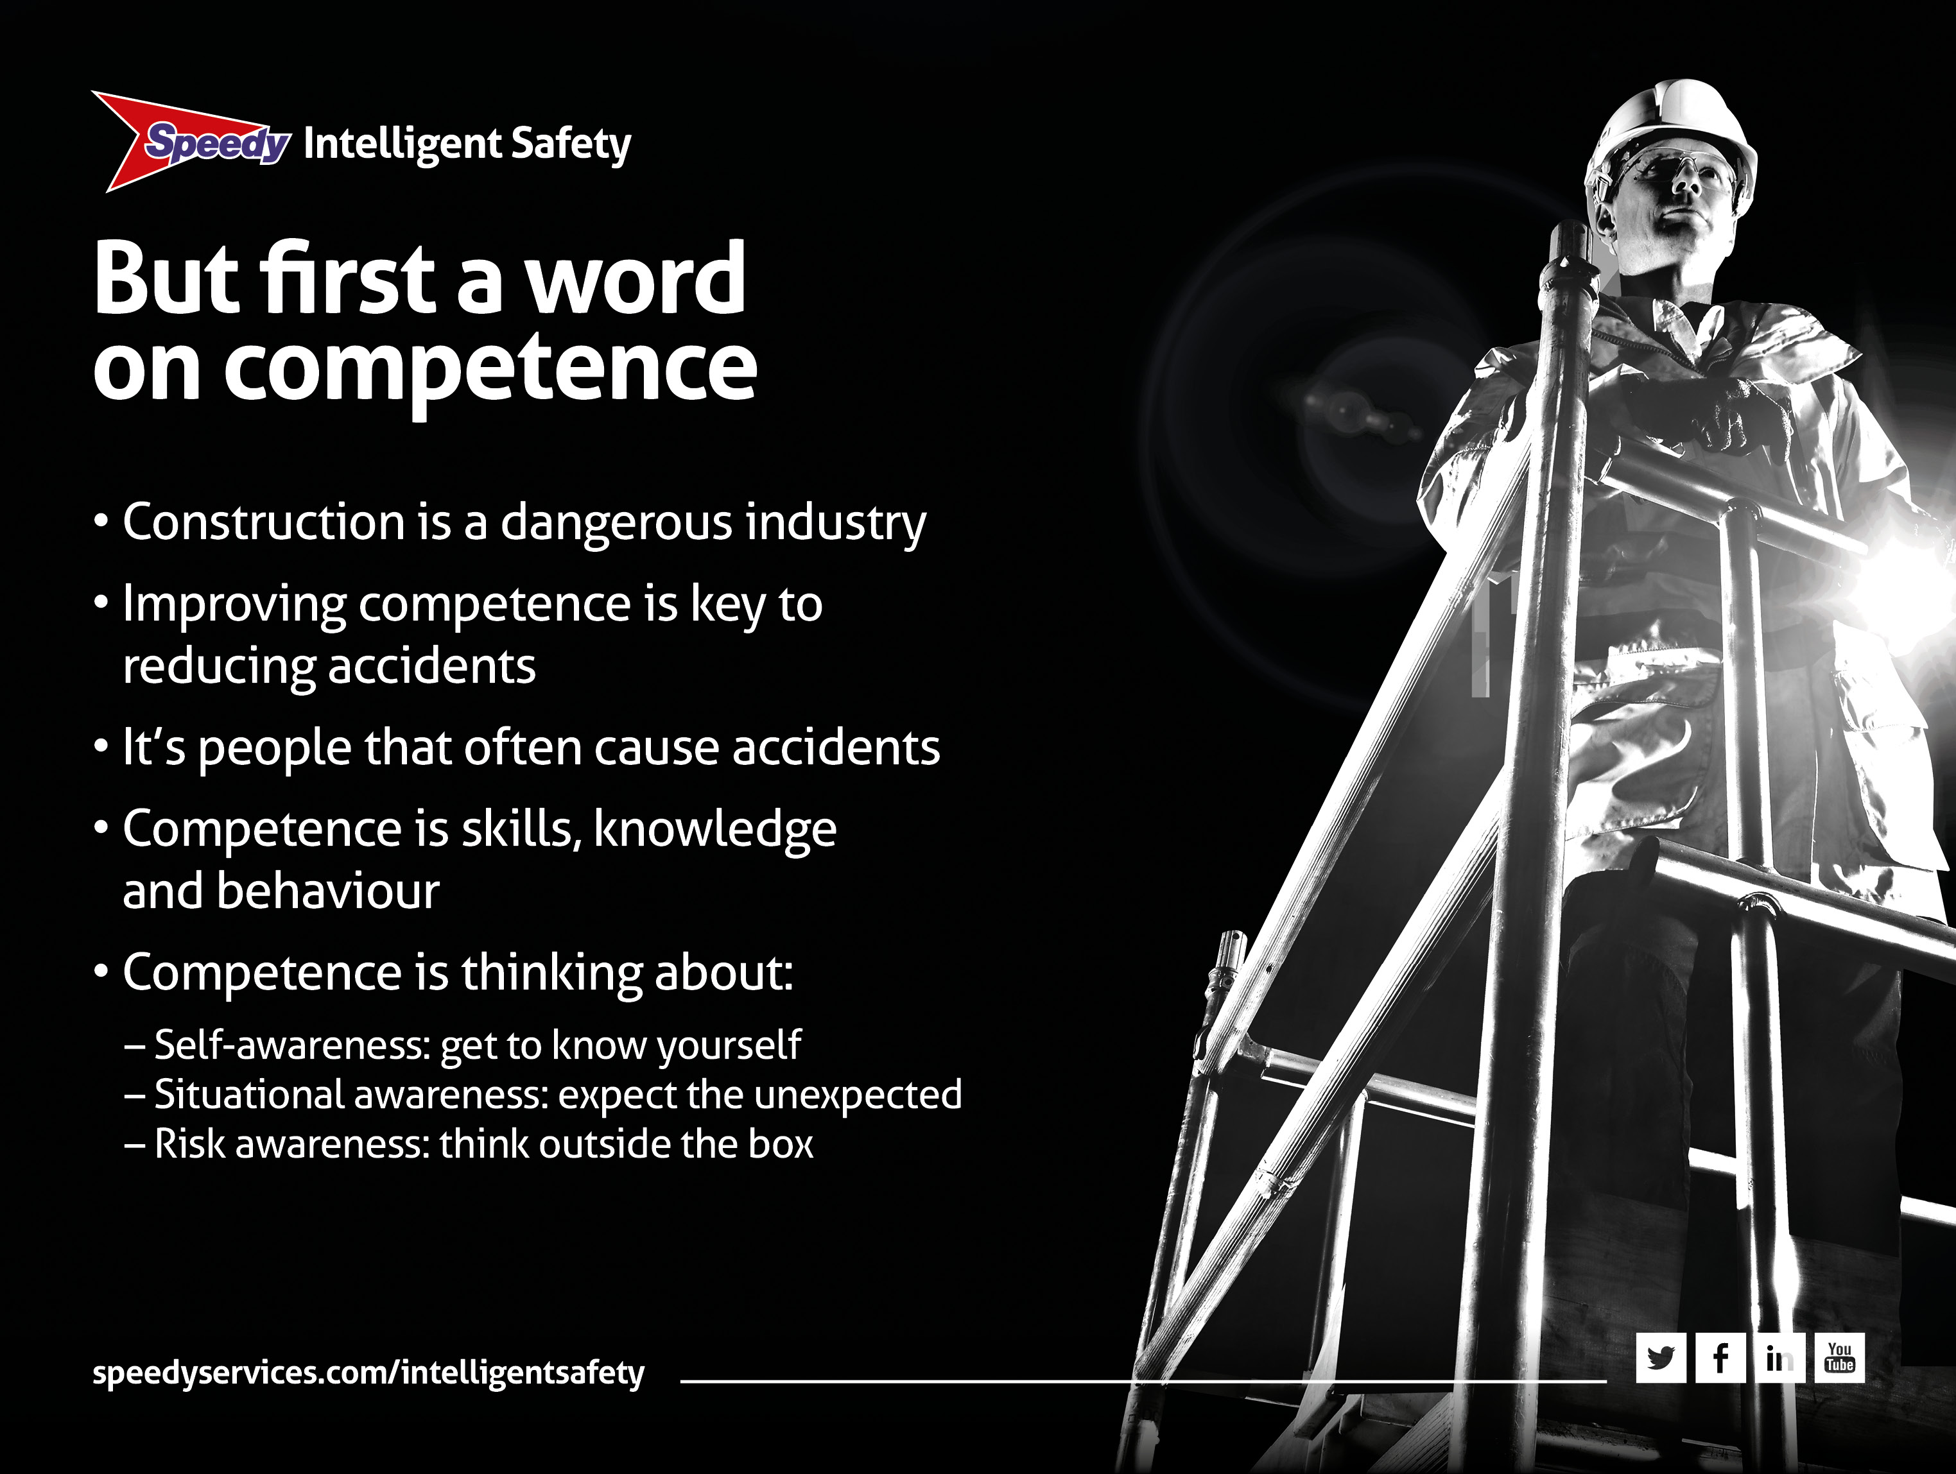
Notes:
But first a word on competence
• Standards of safety are improving all the time
• But construction is a dangerous occupation. Around 50 people die a year (that’s on average one a week) and thousands suffer ill health
• The industry believes that improving competence will reduce accidents
• But what is competence? We think of it as the skills and the know-how to do the job. BUT it is also about behaviour and the attitudes of people...because, it’s people that often cause accidents. It involves:
– Self-awareness: get to know yourself
– Situational awareness: expect the unexpected
– Risk awareness: think outside the box.

Slide 4
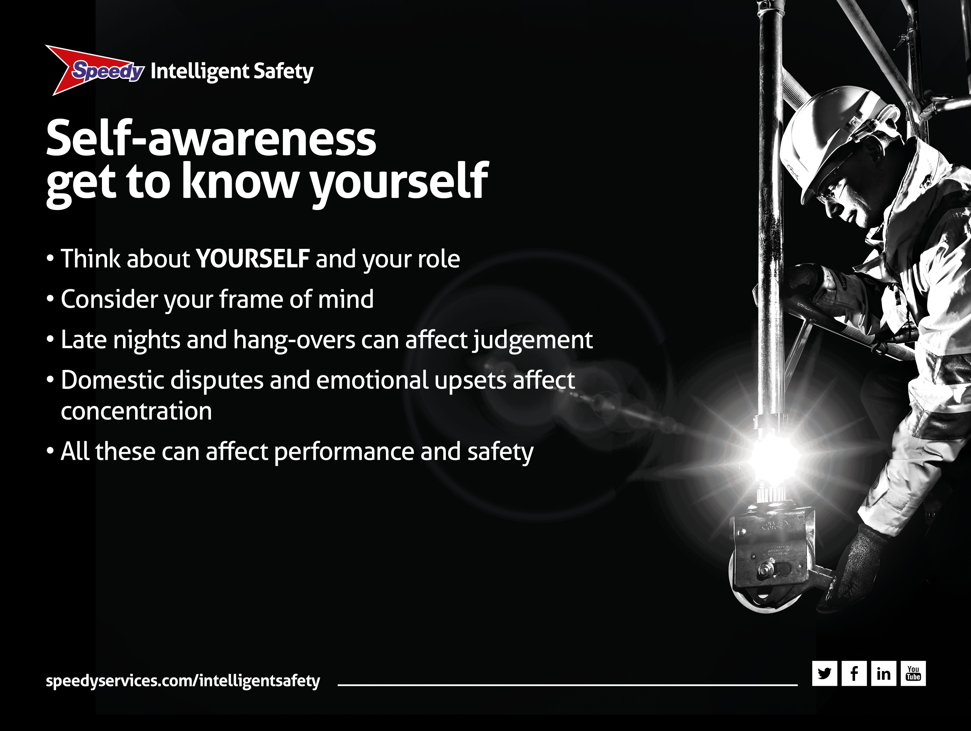
Notes:
Self-awareness: get to know yourself
• This is where the person considers themself and their personal role in the process
• That means YOU and your frame of mind
• Late nights or hang-overs can all affect your judgement
• Domestic disputes like rows, emotional upsets, and stress can affect your attitude and concentration
• All that can affect your performance, your safety and the safety of others.

Slide 5
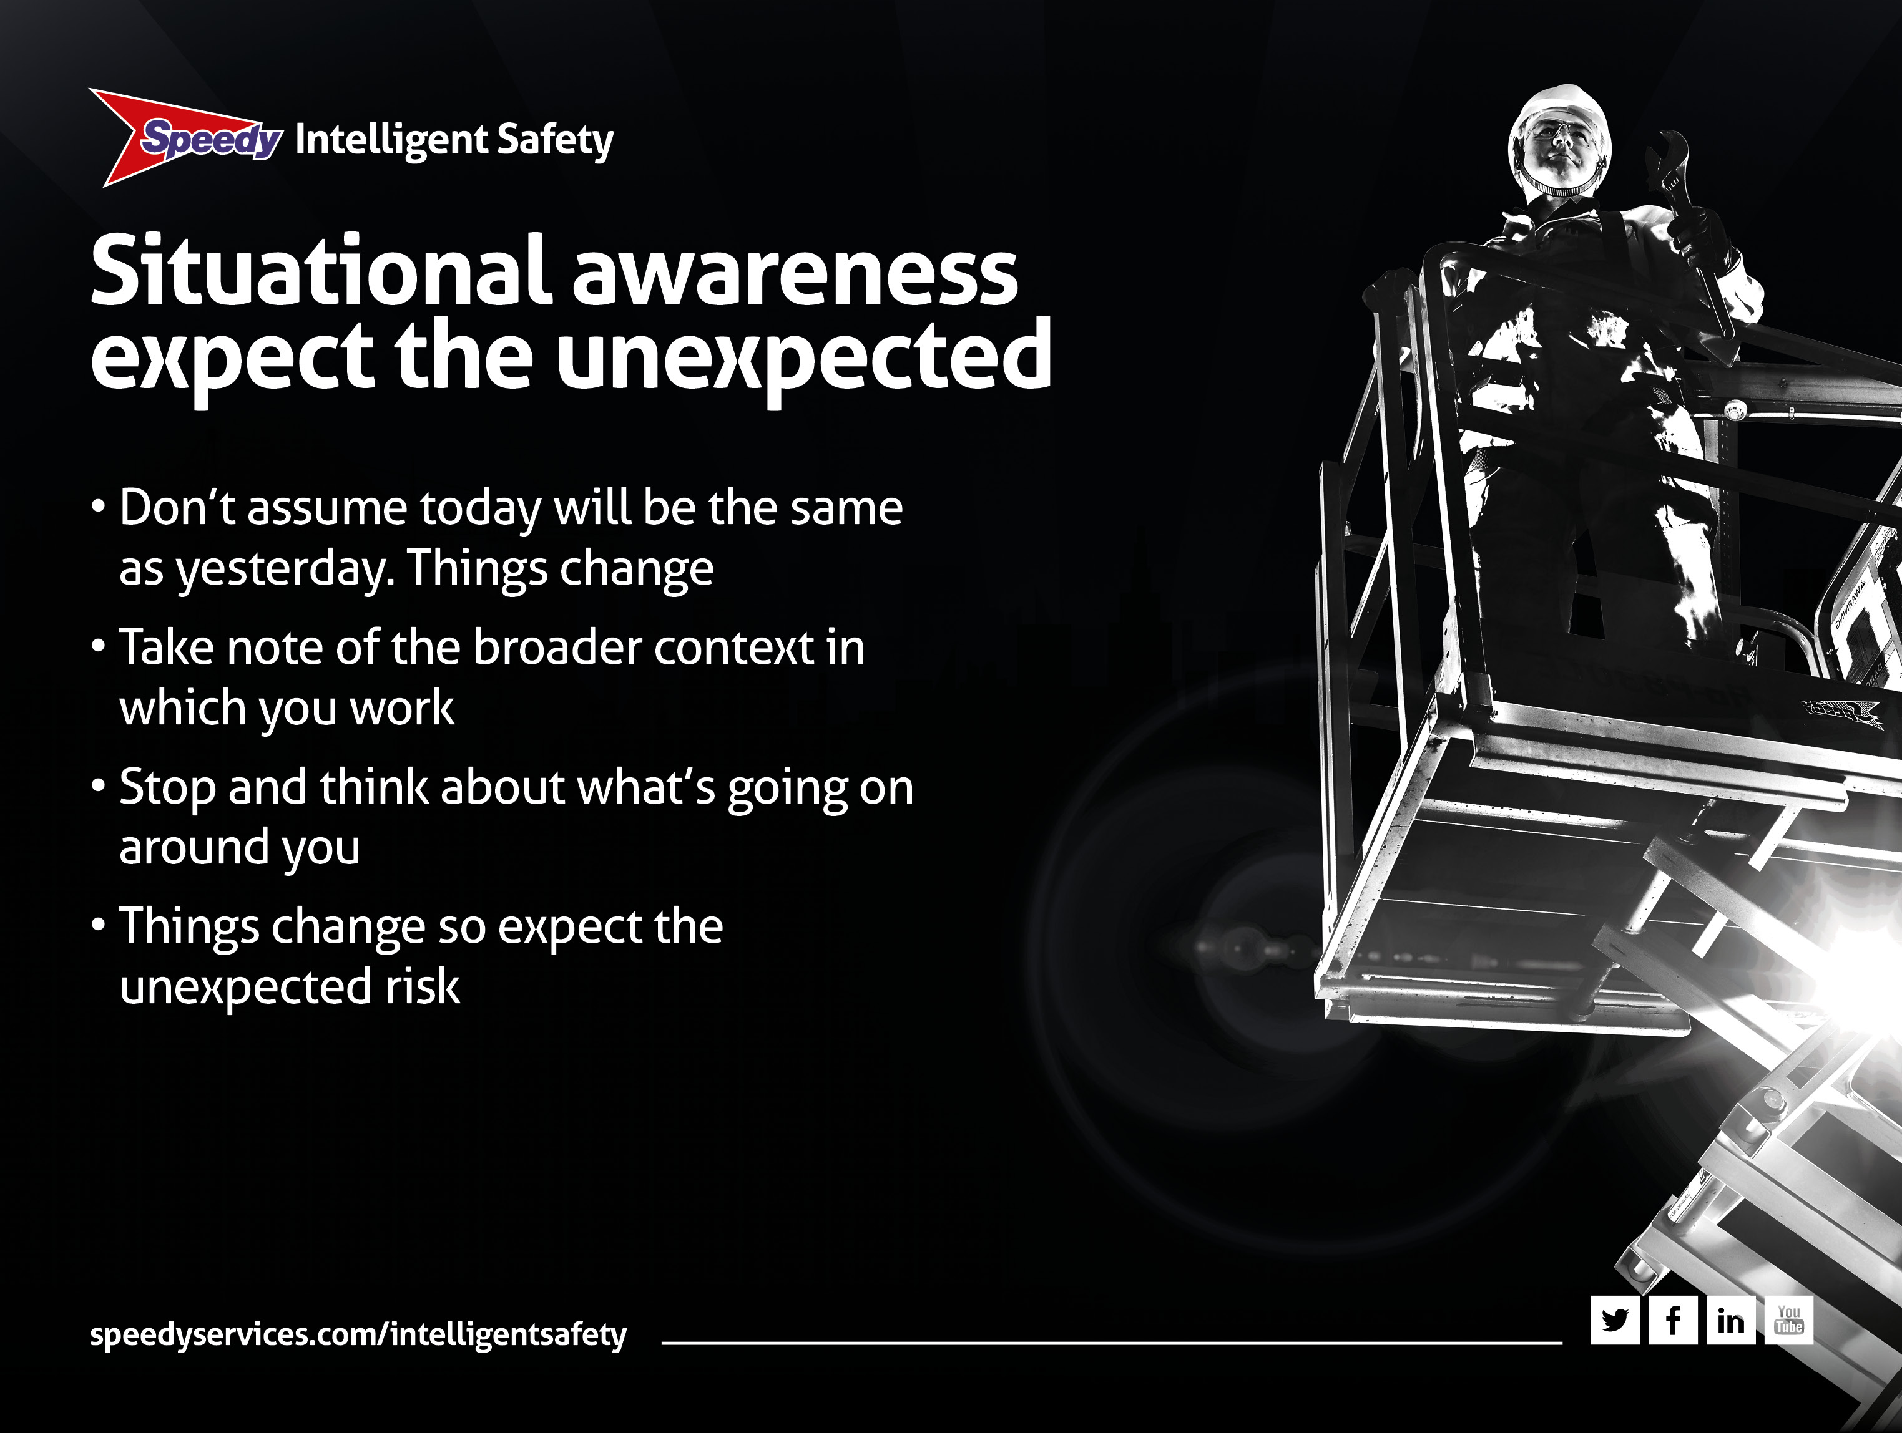
Notes:
Situational awareness: expect the unexpected
• Don’t assume that today will be the same as yesterday. Things change
• Situational awareness means taking note of the broader context in which you are working
• Take a moment to stop and think about what is going on around you
• For example – one minute there’s a track across a site and two hours later someone has dug a hole, ready for you to fall in. It wasn’t there before!

Slide 6
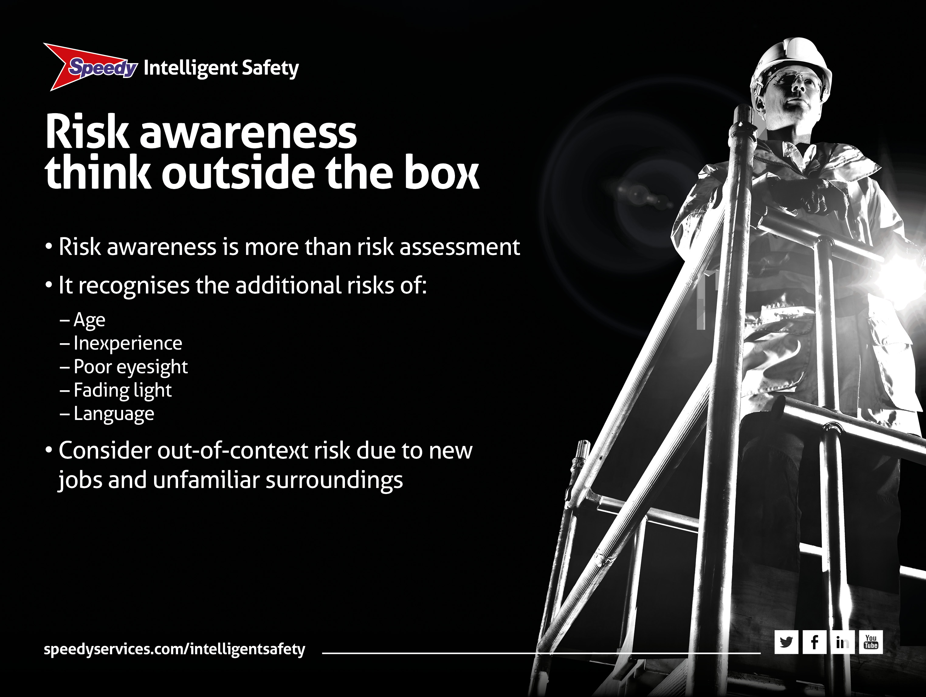
Notes:
Risk awareness: think outside the box
• Risk awareness is more than risk assessment
• It recognises the increased risks that relate to things beyond normal risk assessment
• Such as age, inexperience, poor eyesight, fading light and language
• A good example is out-of-context risk, where risk is increased because of working in a different part of the site or on a new job or in unfamiliar surroundings
• An example of this could be an electrician who is used to working at ground level who suddenly has to install cabling at height, in a roof void.

Slide 7
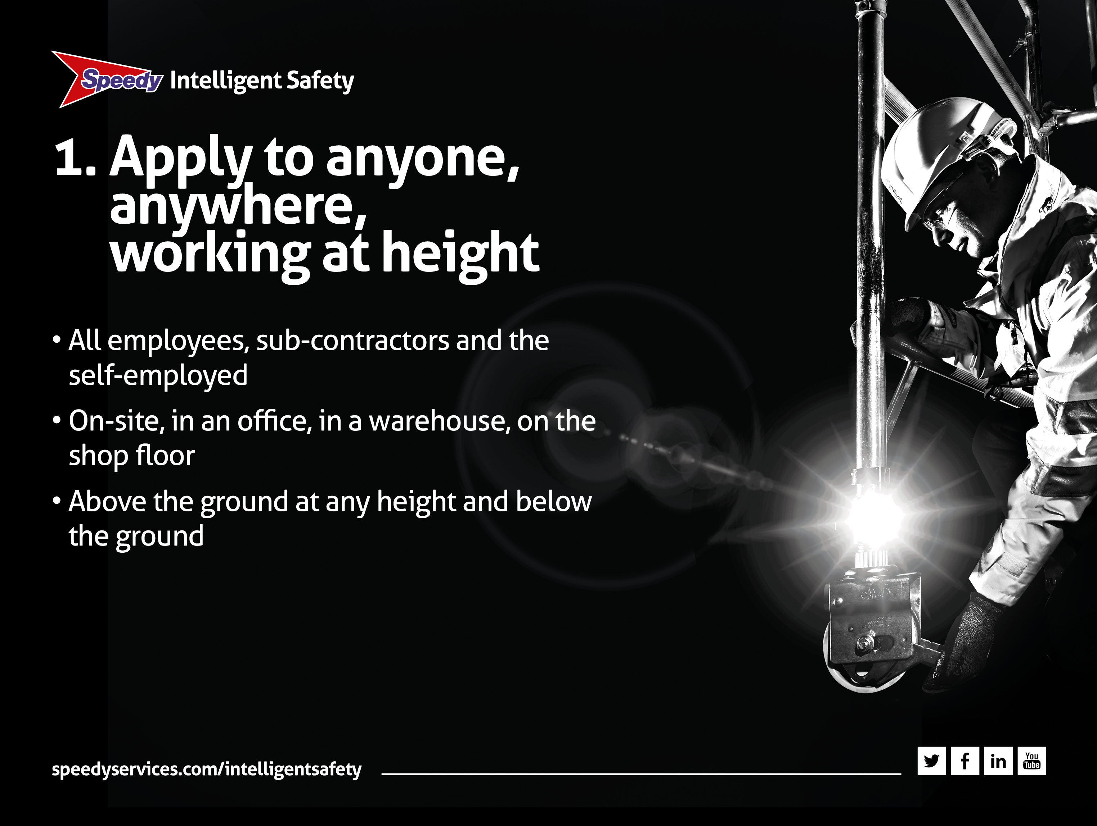
Notes:
Apply to anyone, anywhere, working at height
• So now let’s talk about the six principles of the Work at Height Regulations 2005 (as amended)
• The first principle is that:
– They Apply to anyone: whether you are an employee, from an office temp to the big boss, or self-employed or a sub-contractor. It applies to you
– Anywhere: it doesn’t matter if you are on-site, in an office or stacking hay in a field. It applies to you
– At any height: if you thought that working at height meant over two metres think again. It means at any height above or below ground. So, working alongside or in a hole is still regarded as working at height.

Slide 8
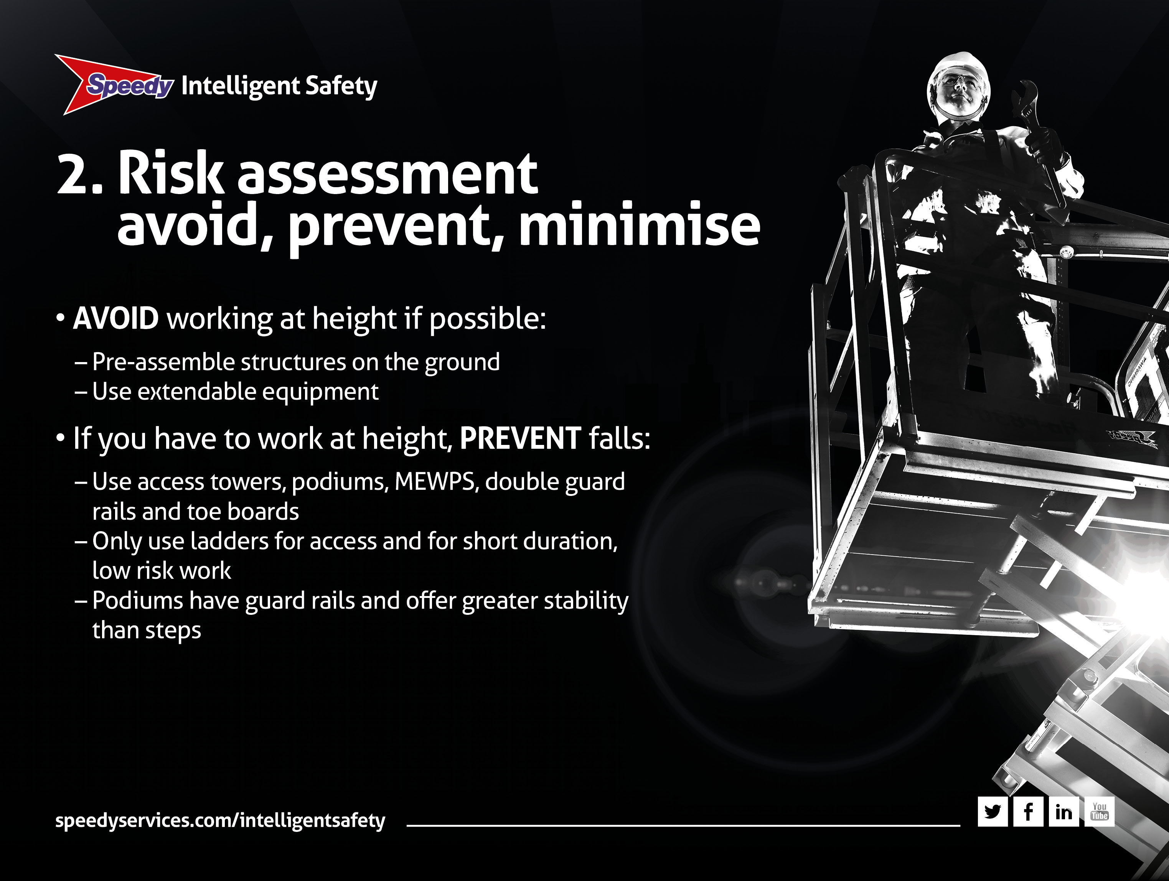
Notes:
2. Risk assessment – avoid, prevent, minimise
• As you know risk assessment is crucial and the HSE break it down into three stages. It’s called a ‘hierarchy of control’: AVOID, PREVENT, MINIMISE.
AVOID – so, first ask ‘do I need to work at height at all?’
• Could you assemble a structure on the ground?
• Could you use an extendable tool instead to do the job e.g. a window cleaner using a telescopic pole with a brush attachment?

Slide 9
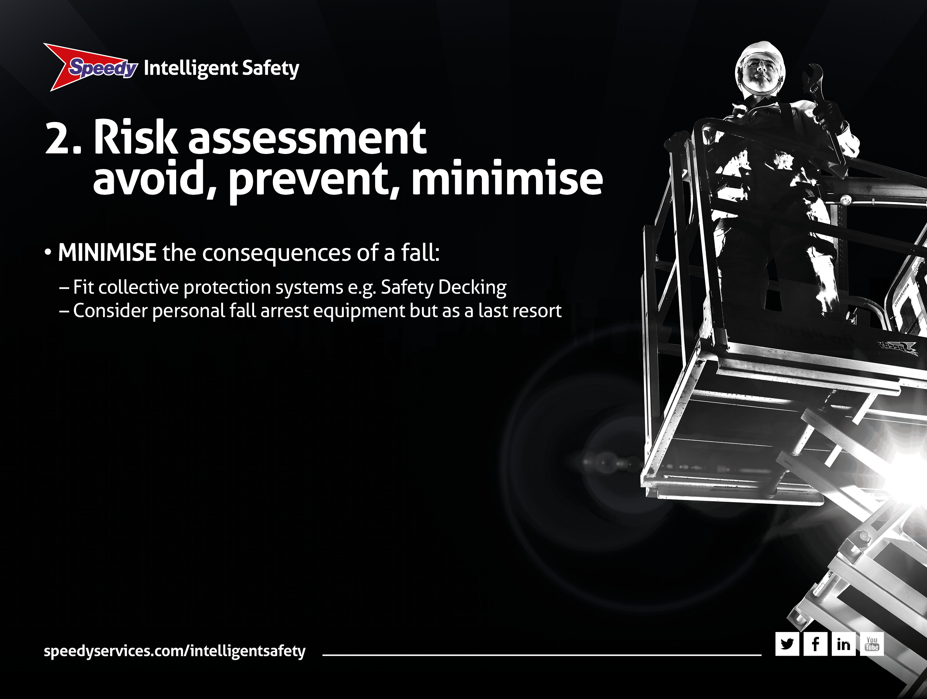
Notes:
2. Risk assessment – avoid, prevent, minimise
PREVENT – if you have to work at height do everything possible to prevent a fall
• Use towers with guardrails, podiums, scissor lifts, roof anchors, MEWPS and low level access
• Only use ladders for temporary or short duration, low risk work
• Use podiums instead of steps as they have guard rails and are more stable.
MINIMISE – if you can’t prevent the risk of a fall, minimise the distance and the consequences of that fall
• Think collective protection. Consider Safety Decking and personal fall arrest equipment like harnesses and lanyards but only as a last resort. Remember, you need to plan how to rescue the person if they should fall.

Slide 10
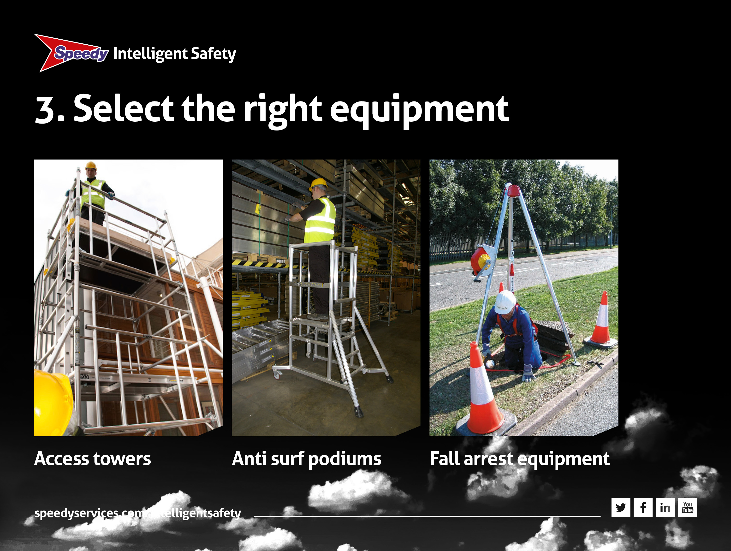
Notes:
3. Select the right equipment
• Select the right equipment. It’s a sensible and professional approach
• We don’t want a ‘make-do’ attitude, where using whatever is handy is the easy option. It isn’t and it’s dangerous and possibly illegal!
• If you need a tower, get a tower. Instead of steps use a podium
• In selecting equipment think about the work environment and ground conditions and how long the job will take and how often you need access
• How high is the work face and can you reach it easily? How far could you fall and what risk is involved when erecting or dismantling the equipment?

Slide 11
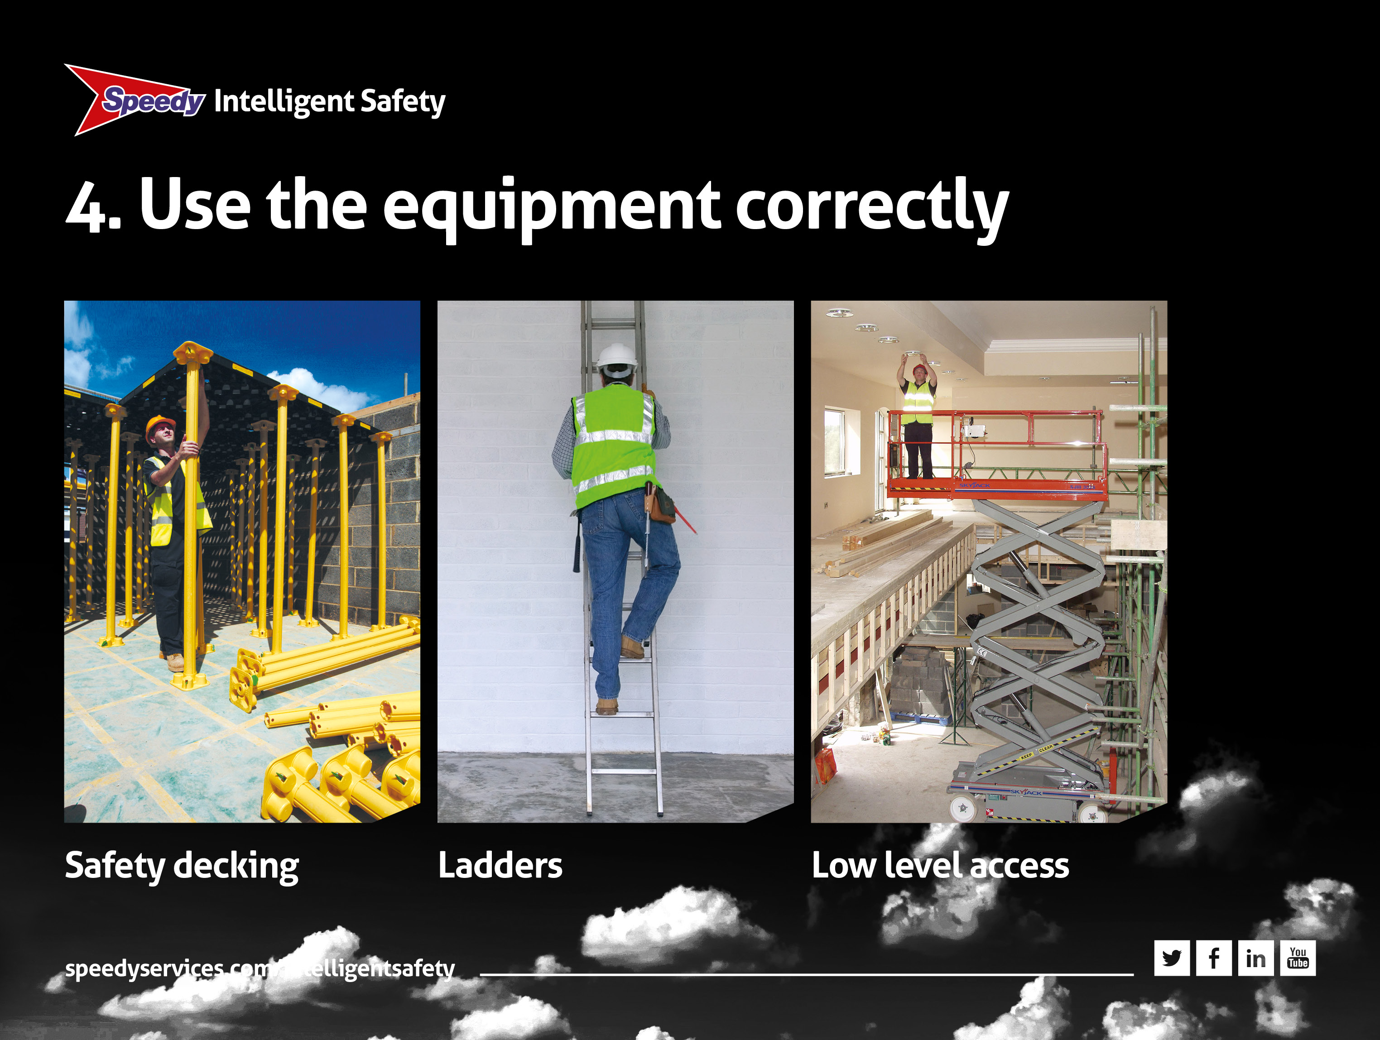
Notes:
4. Use the equipment correctly
• Having selected the right equipment why not use it properly?
• All equipment, especially towers, should be erected by a competent person. This means someone who is trained and proficient in doing the job (e.g. PASMA)
• If you don’t know what you are doing, find someone who does. It’s that simple
• Safety Decking can be used to create a safe working environment. Avoid working on fragile surfaces and consider the weather conditions
• Always follow the manufacturer’s assembly guides and/or the rental company’s hand-over instructions
• With ladders be extra careful. They’re not banned but should only be used for temporary, low risk access and short duration tasks
• If you have to use a ladder, put it at the correct angle, secure it and keep three physical points of contact on it.

Slide 12
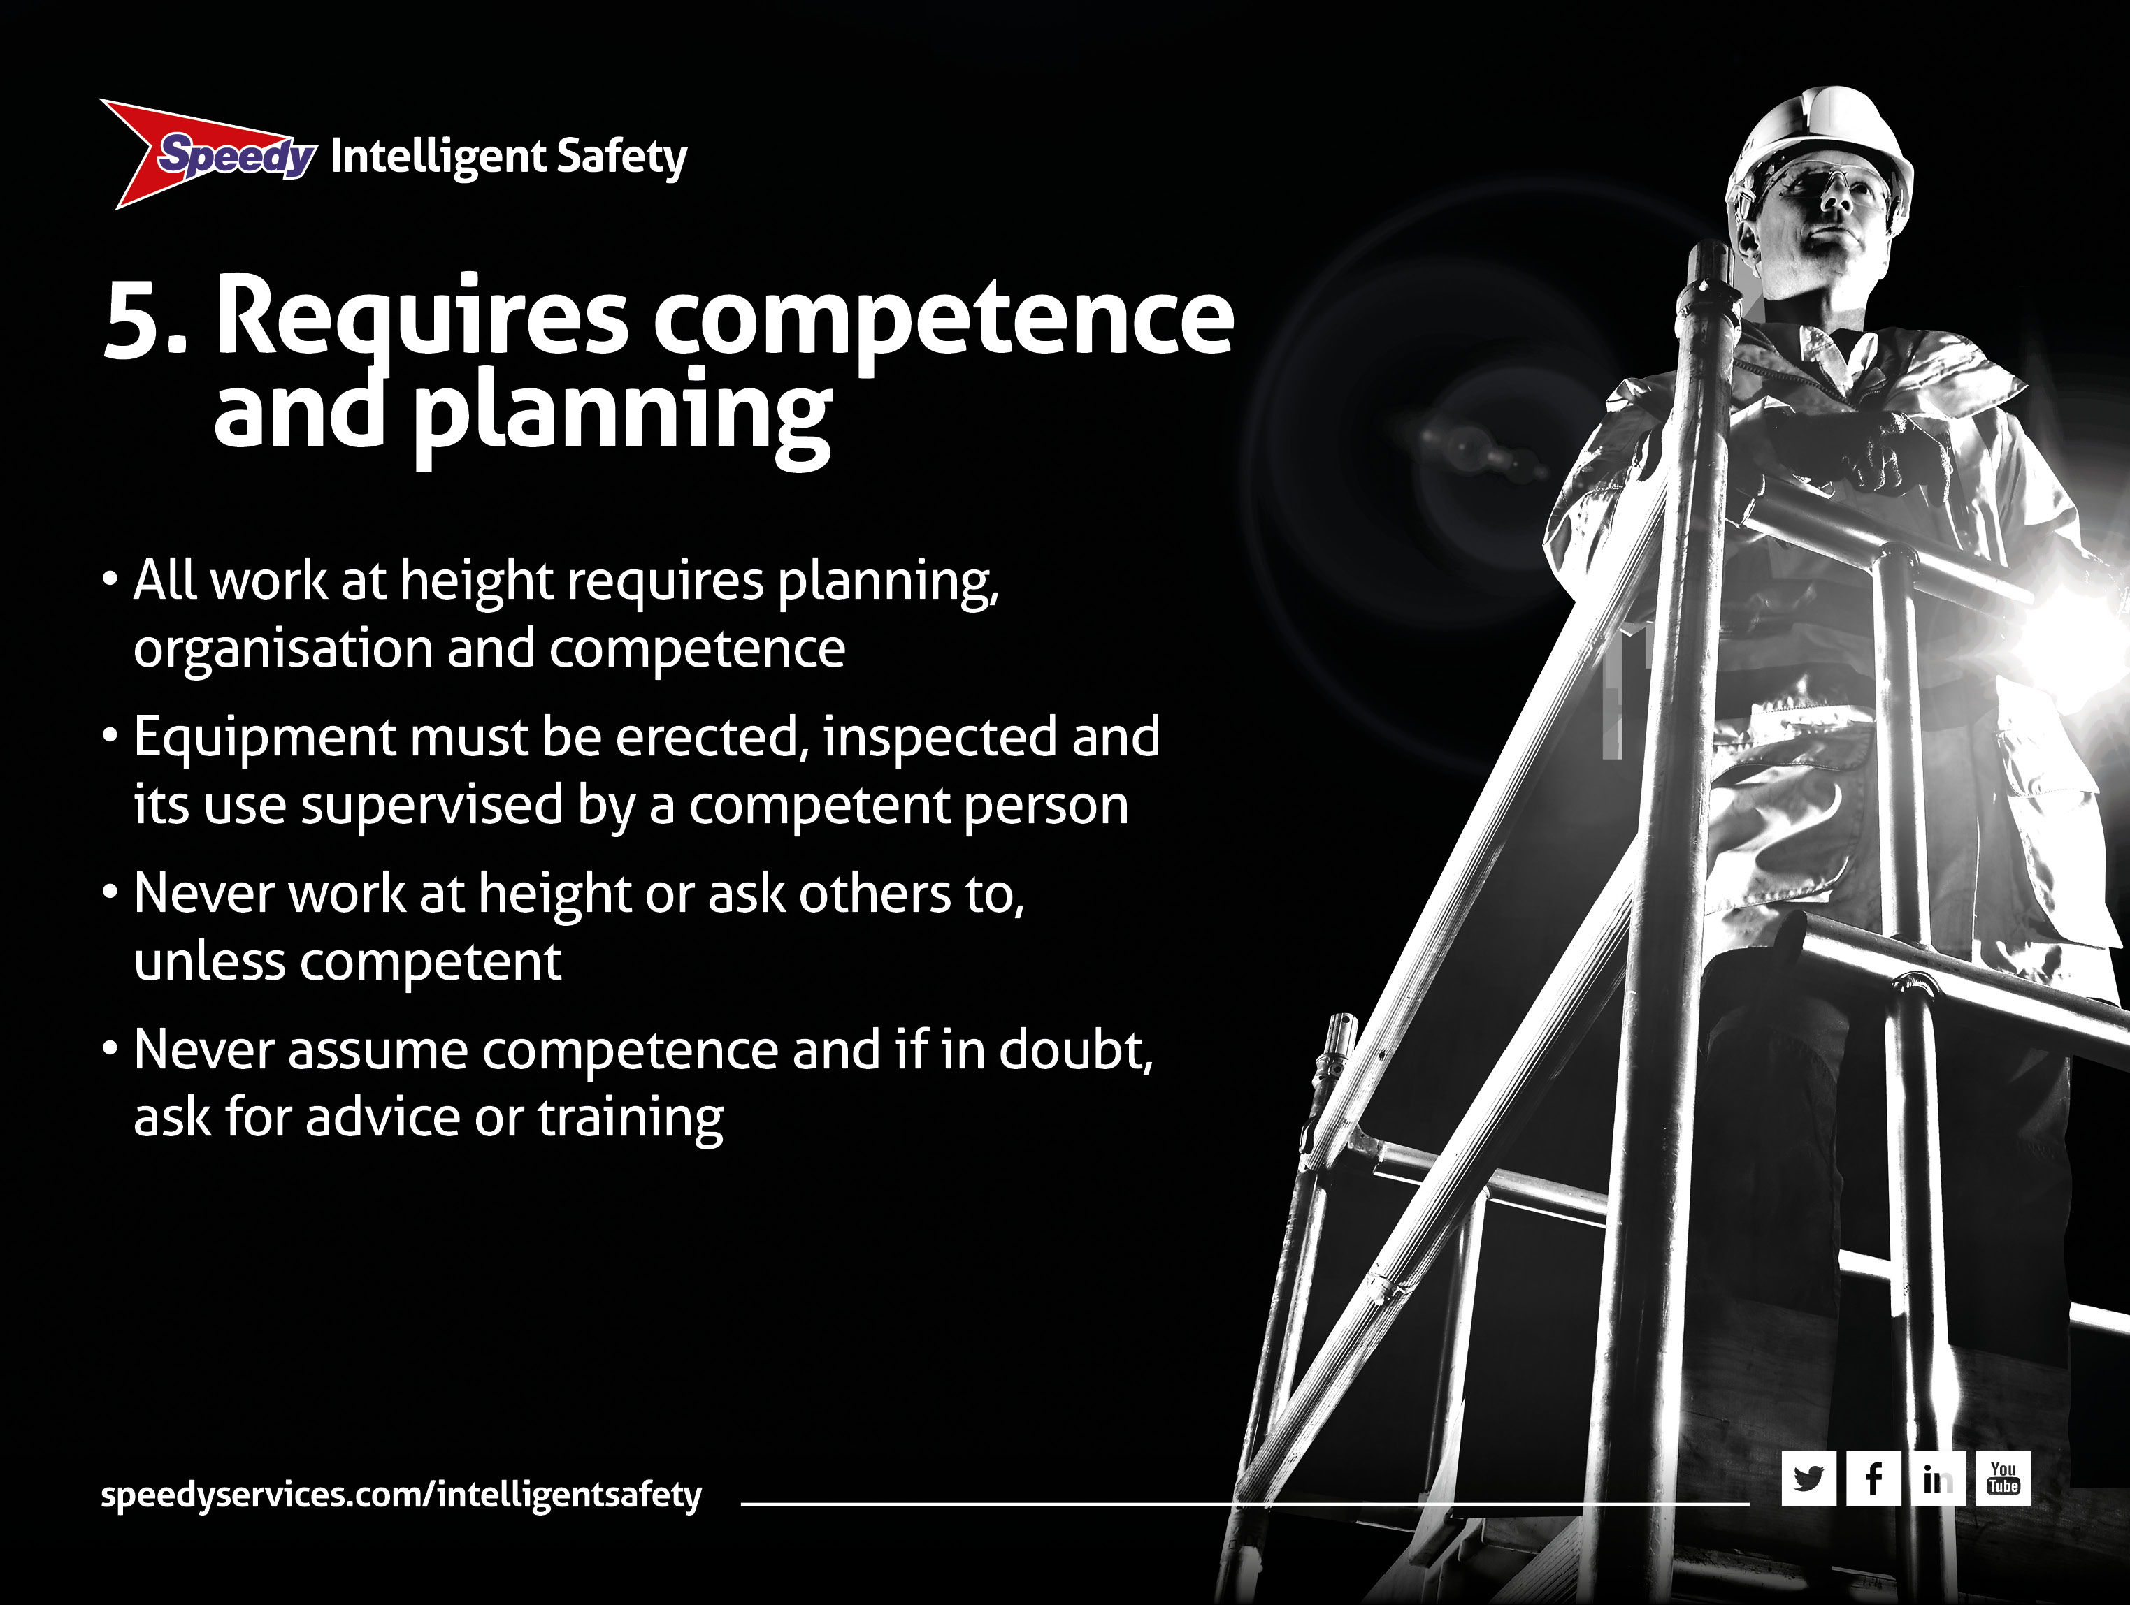
Notes:
5. Requires competence and planning
• This is a critical part of the Work at Height Regulations. It encourages people to think before they act. Remember, can you do the job without the need to work at height?
• Approach working at height in a responsible and professional manner. Competence means someone who is trained or experienced and proficient at doing a job
• All equipment must be erected, inspected and supervised by a competent person
• You should never undertake, or ask anyone else to undertake, a job if they are not competent to do it
• And remember, never assume anything. If in doubt ask for advice.

Slide 13
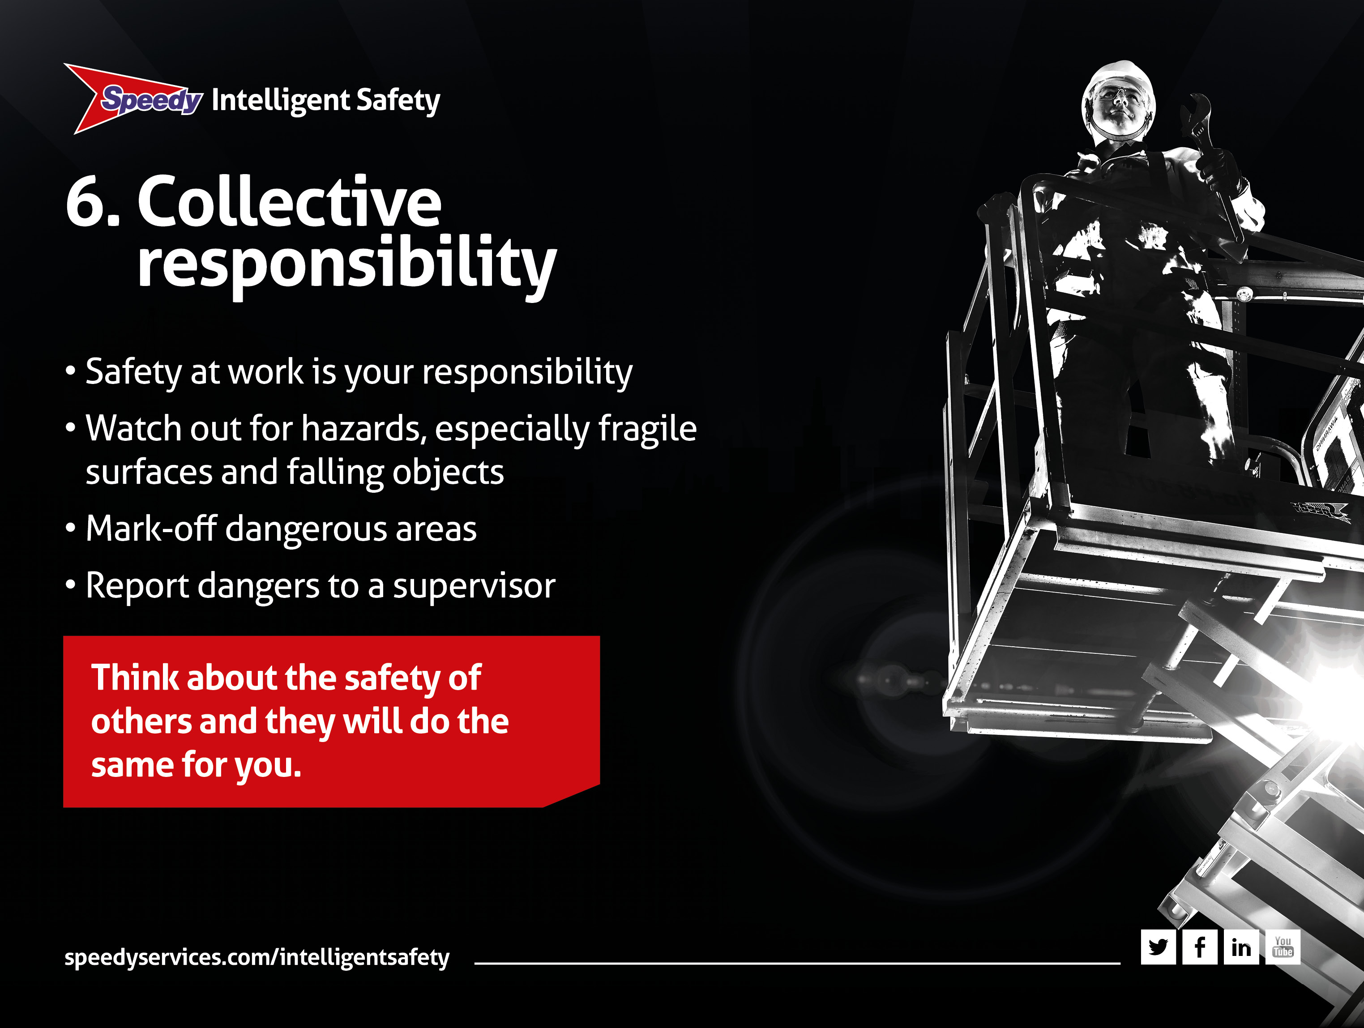
Notes:
6. Collective responsibility
• This means YOU and ME. In fact it means all of us. The idea is simple
• Safety is the responsibility of us all. You look out for yourself of course, but you also look out for your work mates
• It means engaging your brain and using your eyes. Pay particular attention to fragile surfaces and the possibility of falling objects
• If you see something dodgy or potentially unsafe, don’t ignore it. Do something about it
• Mark-off dangerous areas and remember to always TELL your supervisor
• Most accidents are preventable and if you think about the safety of others, they will look out for you.

Slide 14
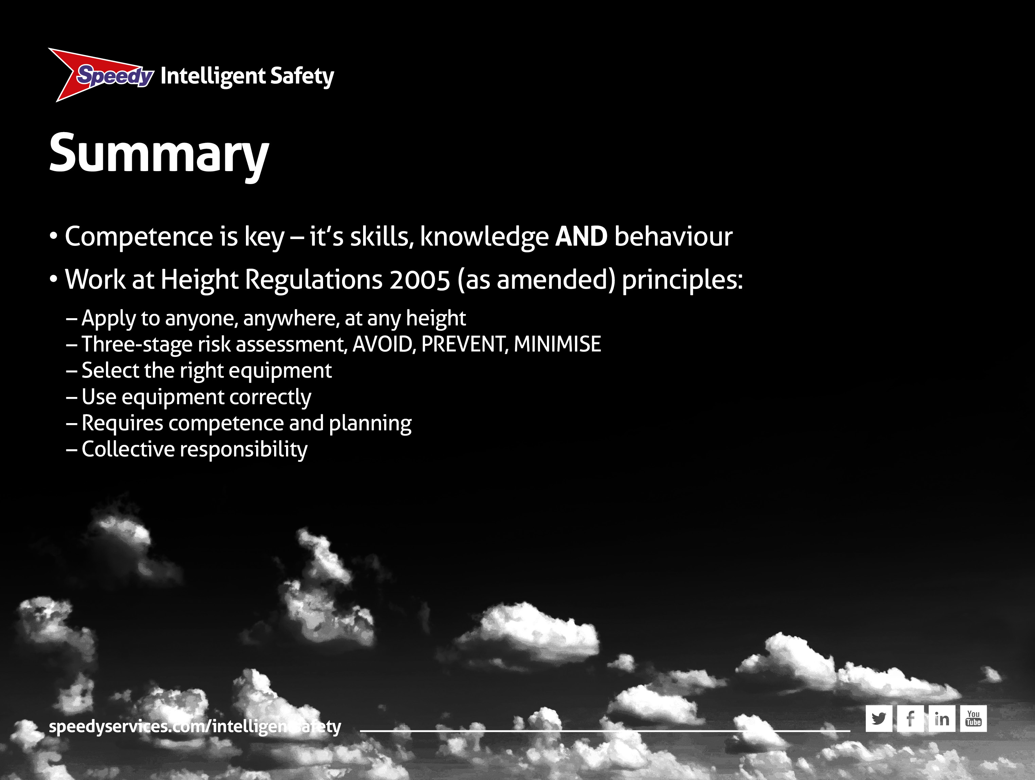
Notes:
Summary
• Competence is key
– it’s skills, knowledge AND behaviour
• Remember Work at Height Regulations 2005 (as amended):
– Applies to anyone, anywhere, at any height
– Risk assessment is a three-stage process AVOID, PREVENT, MINIMISE
– Safe working practice requires selection of the correct equipment
– Having chosen the equipment, use it correctly. Before you start a job, think about it and make sure you and your workmates know what you are doing. If in doubt, ask
– Competence, planning and collective responsibility are all part of the regulations
And finally, before I go, let’s have a quick quiz just to make sure you understand about working at height.

Slide 15
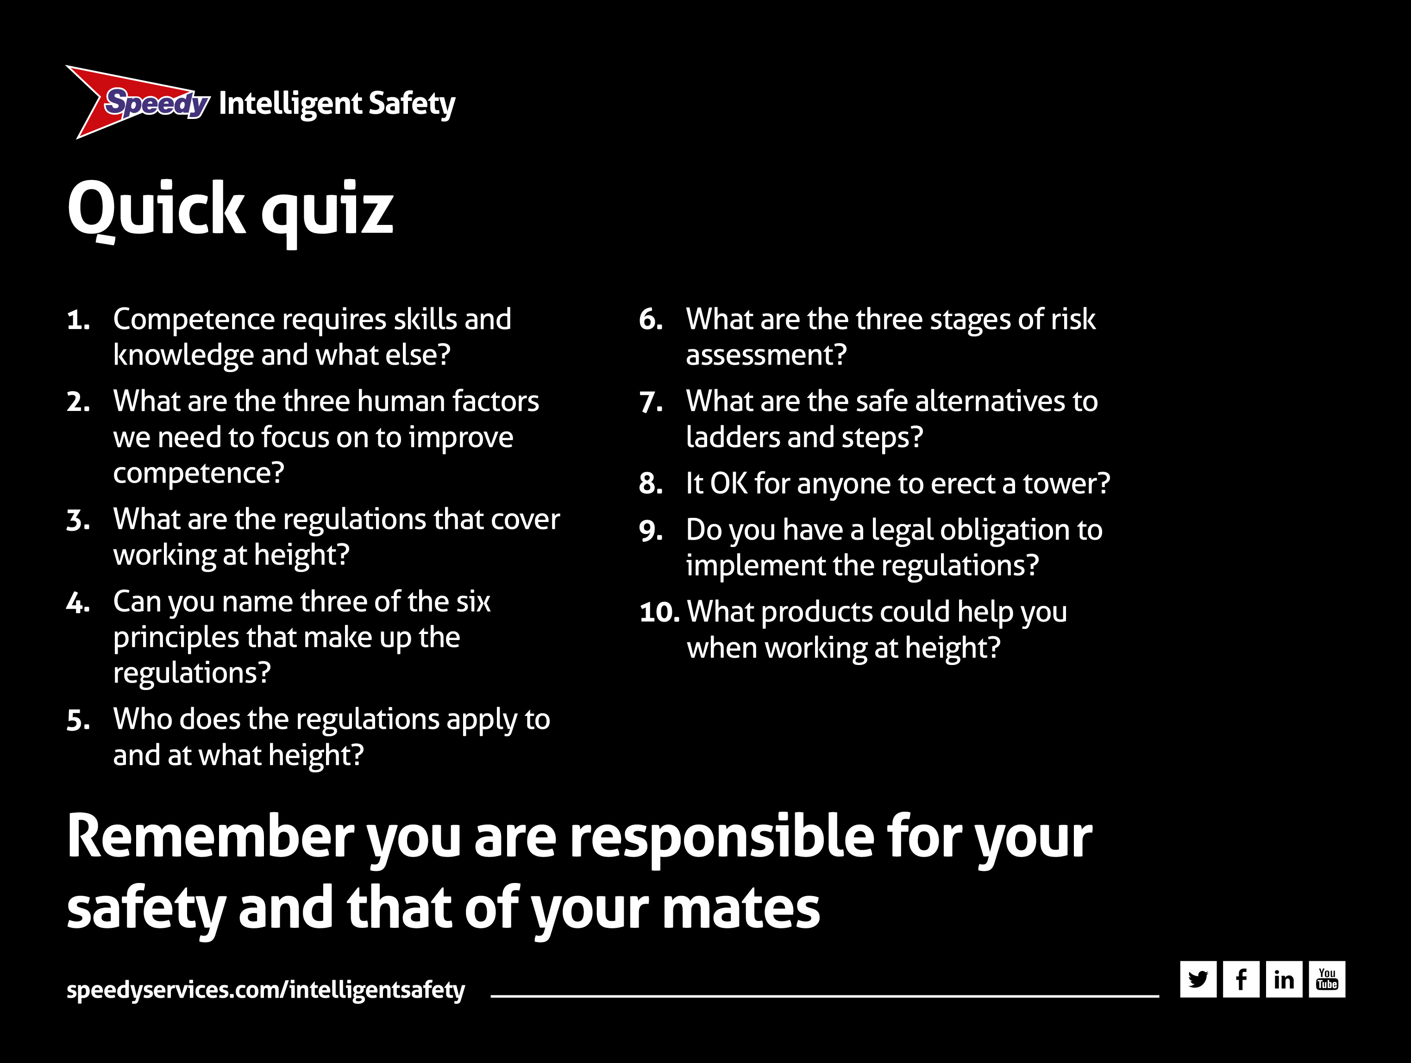
Notes:
Quick quiz
1. Competence requires skills and knowledge and what else?
Behaviour and attitudes – because it’s people that often cause accidents
2. What are the three human factors we need to focus on to improve competence?
Self-awareness, situational awareness and risk awareness
3. What are the regulations that cover working at height?
Work at Height Regulations 2005 (as amended)
4. Can you name three of the six principles that make up the regulations?
Select the right equipment, collective responsibility, use the equipment correctly
5. Who does the regulations apply to and at what height?
Anybody, anywhere and at any height, even below ground level
6. What are the three stages of risk assessment?
Avoid ,prevent, minimise – both distance of a fall and the consequences
7. What are the safe alternatives to ladders and steps?
Podiums, towers. MEWPS, low level access
8. Is it ok for anyone to erect a tower?
No, only someone who has been trained e.g. PASMA
9. Do you have a legal obligation to implement the regulations?
Yes you do and a duty of care to look after yourself AND your mates
10. Which products could help you when working at height?
Safety Decking, fall arrest equipment, air cushions.

