Slide 1

Site Safety
It’s as easy as
abc 123

Slide 2


By working safely, there’s NO reason you should not go home
EVERY NIGHT!

Slide 3


When you first arrive on site, you must sign in including the time you arrived!

Slide 4


Should you leave site even for just 1 minute you must sign out with the time that you left!

Slide 5
Before starting work, the site manager must give you an induction!
Site Rules?
First Aiders?
Fire Exits?
Toilets?
Canteen?
Emergency Procedures?

Slide 6

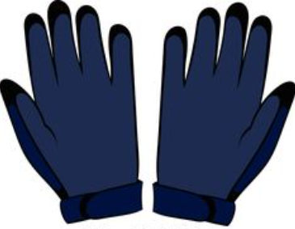



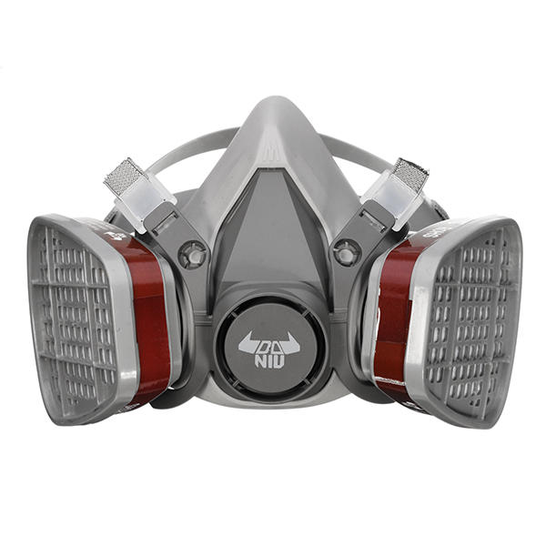

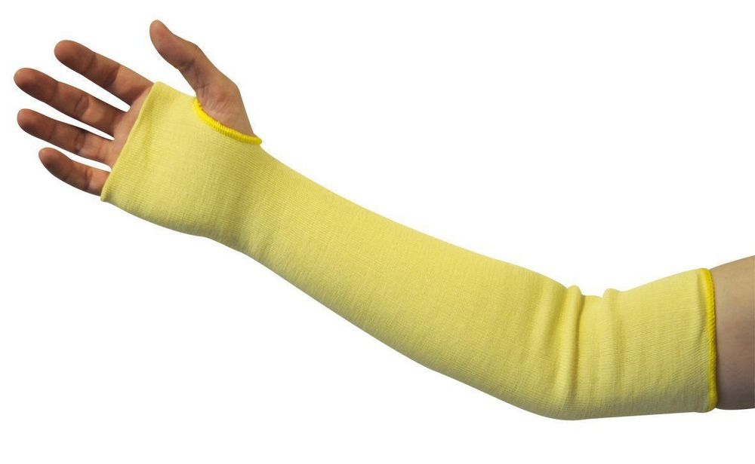
Now you need to get dressed for work!

Slide 7

This site is a 7 Point PPE at ALL TIMES!

Slide 8
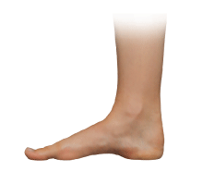
Safety 1
Boots to protect your feet!

Slide 9

Safety 2
Safety helmet to protect your head!

Slide 10

Safety 3
Hi-Visibility clothing so you can be seen!

Slide 11

Safety 4
Cut 3 gloves to protect your fingers!

Slide 12

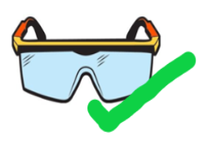
Safety 5
Safety glasses to protect your eyes!

Slide 13

Safety 6
Cut resistant sleeves to protect your arms!

Slide 14
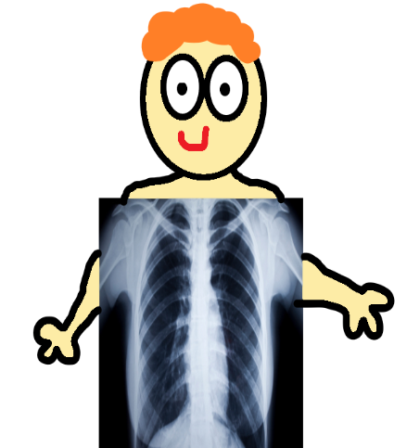
Safety 7
Half face respirator to be worn to protect your lungs!

Slide 15

Now you are almost ready to start work!

Slide 16
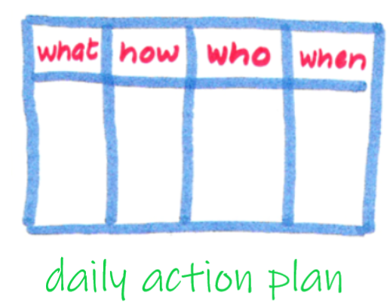
It is necessary to speak to your supervisor to find out your tasks and sign onto daily action plan!

Slide 17



Now have a great day at work…

Slide 18
And when you’ve finished, sign out and go home safe!

Slide 19


This presentation was brought to you by…
Alice G!
Age 11 years , 7 months, 19 days, 20 hours and 30 minutes (at time of writing)

